Slide 1
Ordinary Differential Equation
The methods for Initial Value Problems (IVPs):
Multi-step Methods
Explicit: Euler Forward, Adams-Bashforth
Implicit: Euler Backward, Trapezoidal and Adams-Moulton
Backward Difference Formulae (BDF)
Runge-Kutta Methods
Applications, Startup, Combination Methods (Predictor-Corrector)
Consistency, Stability, Convergence
Application to System of ODEs
Boundary Value Problems (BVPs)
Shooting Method
Direct Methods

Slide 2
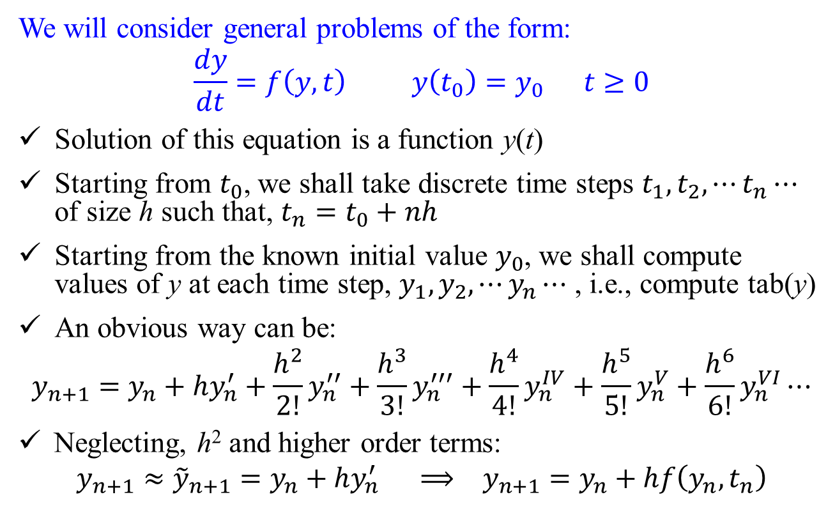
ODE: Introduction
We will consider general problems of the form:
$$\frac{dy}{dt}=f\left(y,t\right) y\left(t_{0}\right)=y_{0} t≥0$$
Solution of this equation is a function y(t)
Starting from $t_{0}$, we shall take discrete time steps $t_{1},t_{2},⋯t_{n}⋯$ of size h such that, $t_{n}=t_{0}+nh$
Starting from the known initial value $y_{0}$, we shall compute values of y at each time step, $y_{1},y_{2},⋯y_{n}⋯$ , i.e., compute tab(y)
An obvious way can be:
$$y_{n+1}=y_{n}+hy_{n}^{′}+\frac{h^{2}}{2!}y_{n}^{′′}+\frac{h^{3}}{3!}y_{n}^{′′′}+\frac{h^{4}}{4!}y_{n}^{IV}+\frac{h^{5}}{5!}y_{n}^{V}+\frac{h^{6}}{6!}y_{n}^{VI}⋯$$
Neglecting, h² and higher order terms:
$$y_{n+1}≈{\tilde{y}}_{n+1}=y_{n}+hy_{n}^{′} ⟹ y_{n+1}=y_{n}+hf\left(y_{n},t_{n}\right)$$

Slide 3
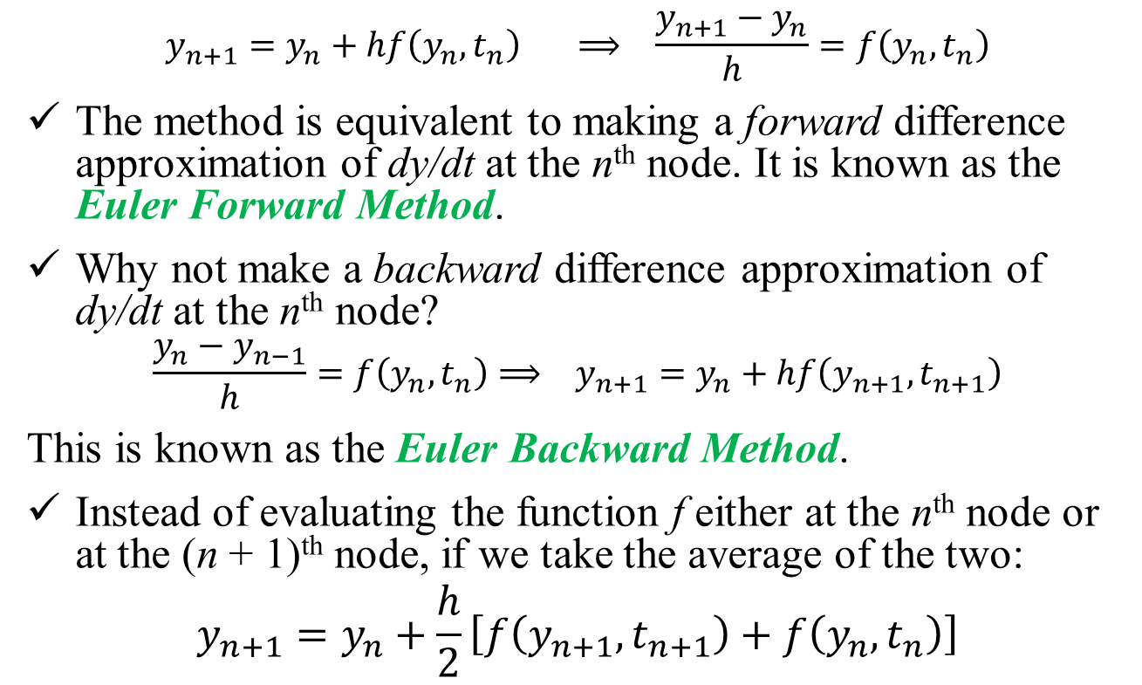
ODE: Introduction
$$y_{n+1}=y_{n}+hf\left(y_{n},t_{n}\right) ⟹ \frac{y_{n+1}−y_{n}}{h}=f\left(y_{n},t_{n}\right)$$
The method is equivalent to making a forward difference approximation of dy/dt at the n^{th} node. It is known as the Euler Forward Method.
Why not make a backward difference approximation of dy/dt at the n^{th} node?
$$\frac{y_{n}−y_{n−1}}{h}=f\left(y_{n},t_{n}\right)⟹ y_{n+1}=y_{n}+hf\left(y_{n+1},t_{n+1}\right)$$
This is known as the Euler Backward Method.
Instead of evaluating the function f either at the n^{th} node or at the (n + 1)^{th} node, if we take the average of the two:
$$y_{n+1}=y_{n}+\frac{h}{2}\left[f\left(y_{n+1},t_{n+1}\right)+f\left(y_{n},t_{n}\right)\right]$$

Slide 4
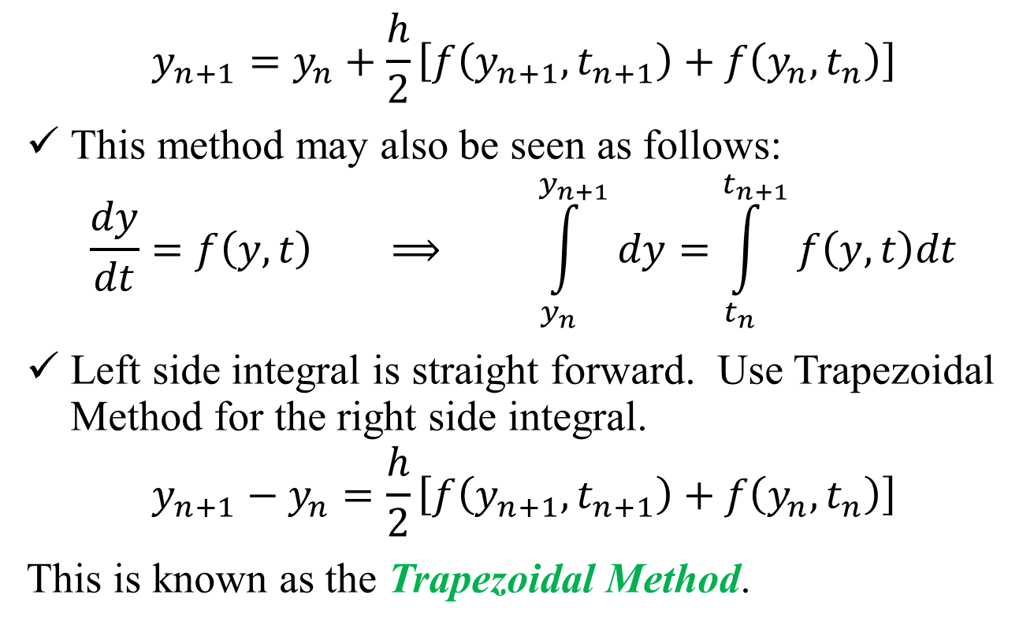
ODE: Introduction
$$y_{n+1}=y_{n}+\frac{h}{2}\left[f\left(y_{n+1},t_{n+1}\right)+f\left(y_{n},t_{n}\right)\right]$$
This method may also be seen as follows:
$$\frac{dy}{dt}=f\left(y,t\right) ⟹ \int_{y_{n}}^{y_{n+1}}{dy}=\int_{t_{n}}^{t_{n+1}}{f\left(y,t\right)dt}$$
Left side integral is straight forward. Use Trapezoidal Method for the right side integral.
$$y_{n+1}−y_{n}=\frac{h}{2}\left[f\left(y_{n+1},t_{n+1}\right)+f\left(y_{n},t_{n}\right)\right]$$
This is known as the Trapezoidal Method.

Slide 5
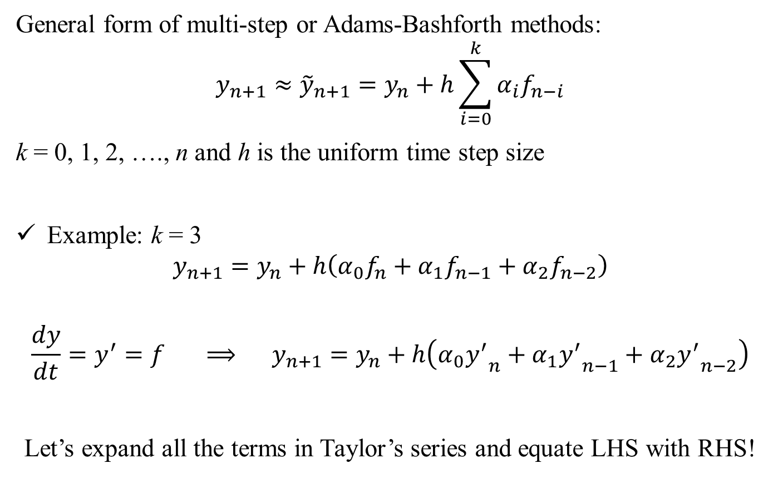
Multi-Step Methods: Explicit
,
General form of multi-step or Adams-Bashforth methods:
$$y_{n+1}≈{\tilde{y}}_{n+1}=y_{n}+h\sum_{i=0}^{k}{α_{i}f_{n−i}}$$
k = 0, 1, 2, …., n and h is the uniform time step size
Example: k = 3
$$y_{n+1}=y_{n}+h\left(α_{0}f_{n}+α_{1}f_{n−1}+α_{2}f_{n−2}\right)$$
$$\frac{dy}{dt}=y^{′}=f ⟹ y_{n+1}=y_{n}+h\left(α_{0}{y^{′}}_{n}+α_{1}{y^{′}}_{n−1}+α_{2}{y^{′}}_{n−2}\right)$$
Let’s expand all the terms in Taylor’s series and equate LHS with RHS!

Slide 6
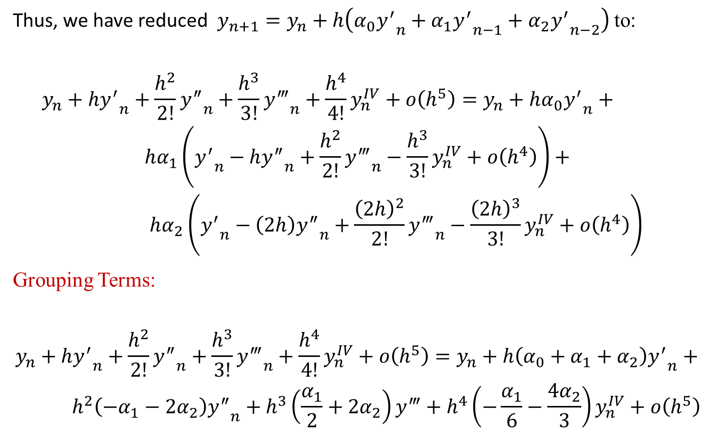
Multi-Step Methods: Explicit
,
Thus, we have reduced $y_{n+1}=y_{n}+h\left(α_{0}{y^{′}}_{n}+α_{1}{y^{′}}_{n−1}+α_{2}{y^{′}}_{n−2}\right)$ to:
$$\begin{matrix}y_{n}+h{y^{′}}_{n}+\frac{h^{2}}{2!}{y^{″}}_{n}+\frac{h^{3}}{3!}{y^{‴}}_{n}+\frac{h^{4}}{4!}y_{n}^{IV}+ο\left(h^{5}\right)=y_{n}+hα_{0}{y^{′}}_{n}+ \\ hα_{1}\left({y^{′}}_{n}−h{y^{″}}_{n}+\frac{h^{2}}{2!}{y^{‴}}_{n}−\frac{h^{3}}{3!}y_{n}^{IV}+ο\left(h^{4}\right)\right)+ \\ hα_{2}\left({y^{′}}_{n}−\left(2h\right){y^{″}}_{n}+\frac{{\left(2h\right)}^{2}}{2!}{y^{‴}}_{n}−\frac{{\left(2h\right)}^{3}}{3!}y_{n}^{IV}+ο\left(h^{4}\right)\right)\end{matrix}$$
Grouping Terms:
$$\begin{matrix}y_{n}+h{y^{′}}_{n}+\frac{h^{2}}{2!}{y^{″}}_{n}+\frac{h^{3}}{3!}{y^{‴}}_{n}+\frac{h^{4}}{4!}y_{n}^{IV}+ο\left(h^{5}\right)=y_{n}+h\left(α_{0}+α_{1}+α_{2}\right){y^{′}}_{n}+ \\ h^{2}\left(−α_{1}−2α_{2}\right){y^{″}}_{n}+h^{3}\left(\frac{α_{1}}{2}+2α_{2}\right)y^{‴}+h^{4}\left(−\frac{α_{1}}{6}−\frac{4α_{2}}{3}\right)y_{n}^{IV}+ο\left(h^{5}\right)\end{matrix}$$

Slide 7
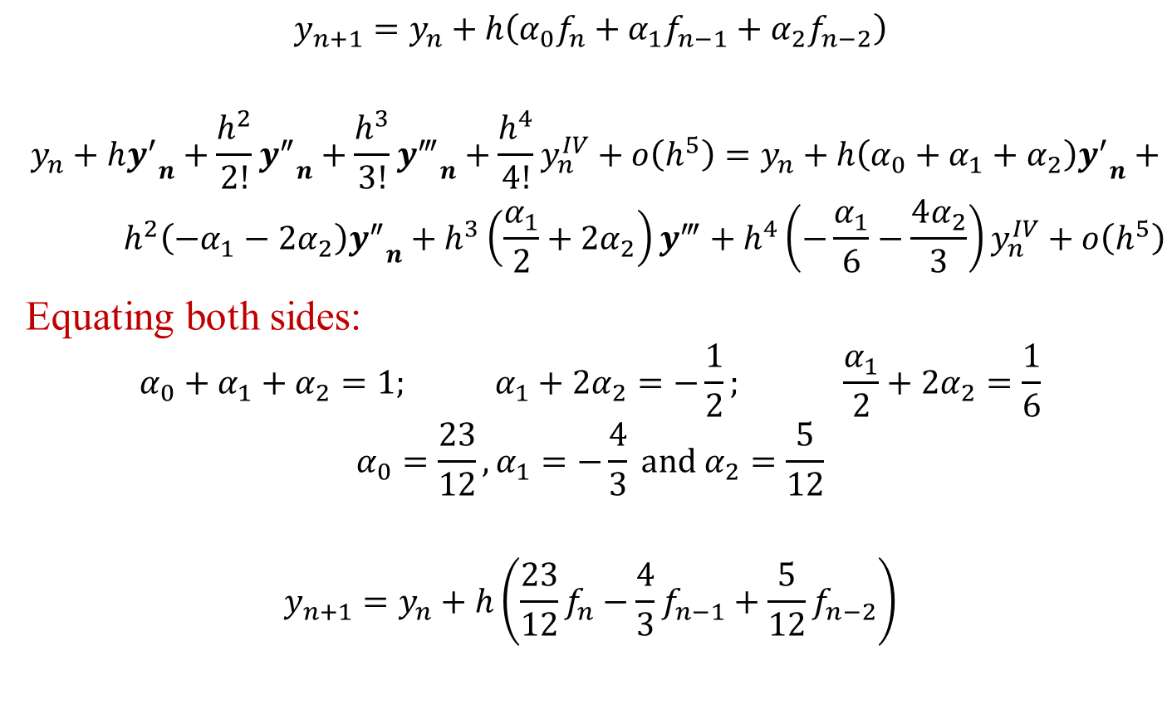
Multi-Step Methods: Explicit
,
$$y_{n+1}=y_{n}+h\left(α_{0}f_{n}+α_{1}f_{n−1}+α_{2}f_{n−2}\right)$$
$$\begin{matrix}y_{n}+h{y^{′}}_{n}+\frac{h^{2}}{2!}{y^{″}}_{n}+\frac{h^{3}}{3!}{y^{‴}}_{n}+\frac{h^{4}}{4!}y_{n}^{IV}+ο\left(h^{5}\right)=y_{n}+h\left(α_{0}+α_{1}+α_{2}\right){y^{′}}_{n}+ \\ h^{2}\left(−α_{1}−2α_{2}\right){y^{″}}_{n}+h^{3}\left(\frac{α_{1}}{2}+2α_{2}\right)y^{‴}+h^{4}\left(−\frac{α_{1}}{6}−\frac{4α_{2}}{3}\right)y_{n}^{IV}+ο\left(h^{5}\right)\end{matrix}$$
Equating both sides:
$$α_{0}+α_{1}+α_{2}=1; α_{1}+2α_{2}=−\frac{1}{2}; \frac{α_{1}}{2}+2α_{2}=\frac{1}{6}$$
$$α_{0}=\frac{23}{12},α_{1}=−\frac{4}{3} \text{and} α_{2}=\frac{5}{12}$$
$$y_{n+1}=y_{n}+h\left(\frac{23}{12}f_{n}−\frac{4}{3}f_{n−1}+\frac{5}{12}f_{n−2}\right)$$

Slide 8
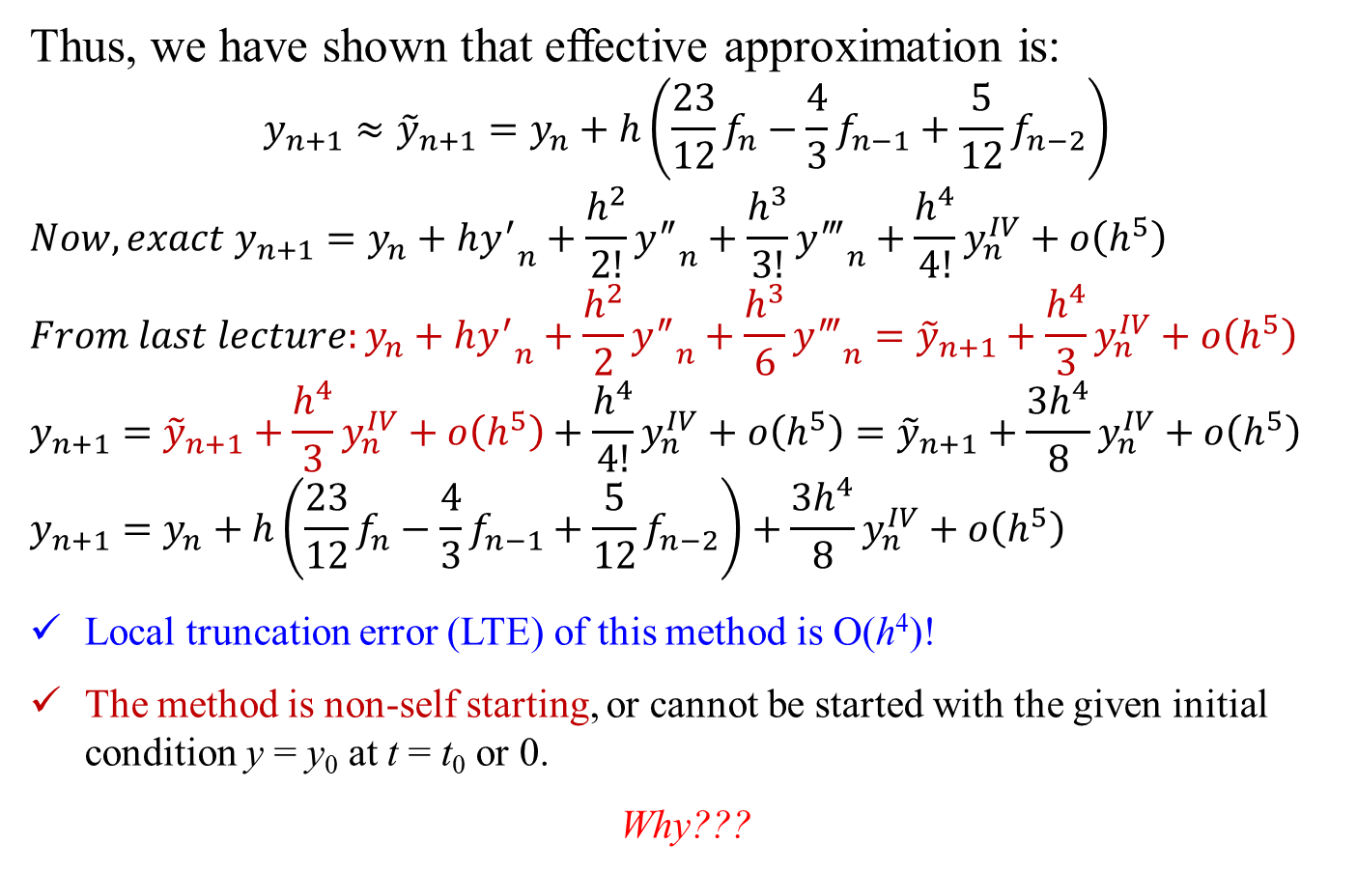
Multi-Step Methods: Explicit
,
Thus, we have shown that effective approximation is:
$$y_{n+1}≈{\tilde{y}}_{n+1}=y_{n}+h\left(\frac{23}{12}f_{n}−\frac{4}{3}f_{n−1}+\frac{5}{12}f_{n−2}\right)$$
$${Now, exact y}_{n+1}=y_{n}+h{y^{′}}_{n}+\frac{h^{2}}{2!}{y^{″}}_{n}+\frac{h^{3}}{3!}{y^{‴}}_{n}+\frac{h^{4}}{4!}y_{n}^{IV}+ο\left(h^{5}\right)$$
$${From last lecture:y}_{n}+h{y^{′}}_{n}+\frac{h^{2}}{2}{y^{″}}_{n}+\frac{h^{3}}{6}{y^{‴}}_{n}={\tilde{y}}_{n+1}+\frac{h^{4}}{3}y_{n}^{IV}+ο\left(h^{5}\right)$$
$$y_{n+1}={\tilde{y}}_{n+1}+\frac{h^{4}}{3}y_{n}^{IV}+ο\left(h^{5}\right)+\frac{h^{4}}{4!}y_{n}^{IV}+ο\left(h^{5}\right)={\tilde{y}}_{n+1}+\frac{3h^{4}}{8}y_{n}^{IV}+ο\left(h^{5}\right)$$
$$y_{n+1}=y_{n}+h\left(\frac{23}{12}f_{n}−\frac{4}{3}f_{n−1}+\frac{5}{12}f_{n−2}\right)+\frac{3h^{4}}{8}y_{n}^{IV}+ο\left(h^{5}\right)$$
Local truncation error (LTE) of this method is O(h⁴)!
The method is non-self starting, or cannot be started with the given initial condition y = y₀ at t = t₀ or 0.
Why???

Slide 9
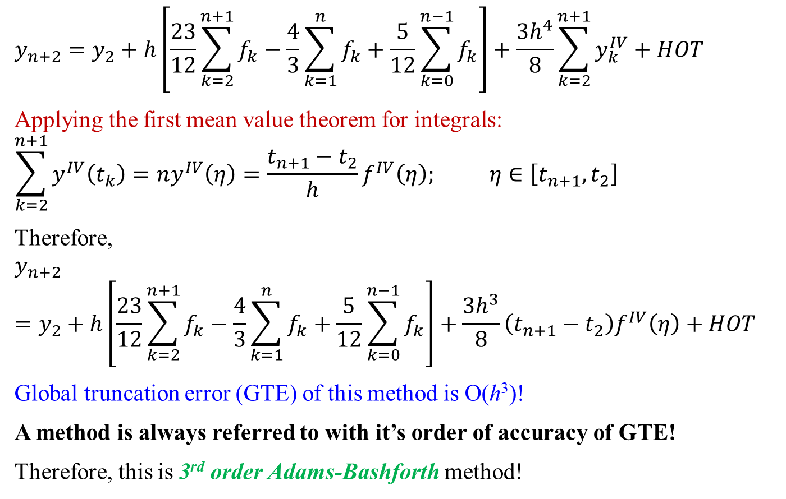
Multi-Step Methods: Explicit
,
$$y_{n+2}=y_{2}+h\left[\frac{23}{12}\sum_{k=2}^{n+1}{f_{k}}−\frac{4}{3}\sum_{k=1}^{n}{f_{k}}+\frac{5}{12}\sum_{k=0}^{n−1}{f_{k}}\right]+\frac{3h^{4}}{8}\sum_{k=2}^{n+1}{y_{k}^{IV}}+HOT$$
Applying the first mean value theorem for integrals:
$$\sum_{k=2}^{n+1}{y^{IV}\left(t_{k}\right)}=ny^{IV}\left(η\right)=\frac{t_{n+1}−t_{2}}{h}f^{IV}\left(η\right); η∈\left[t_{n+1},t_{2}\right]$$
Therefore,
$$y_{n+2}=y_{2}+h\left[\frac{23}{12}\sum_{k=2}^{n+1}{f_{k}}−\frac{4}{3}\sum_{k=1}^{n}{f_{k}}+\frac{5}{12}\sum_{k=0}^{n−1}{f_{k}}\right]+\frac{3h^{3}}{8}\left(t_{n+1}−t_{2}\right)f^{IV}\left(η\right)+HOT$$
Global truncation error (GTE) of this method is O(h³)!
A method is always referred to with it’s order of accuracy of GTE!
Therefore, this is 3rd order Adams-Bashforth method!

Slide 10
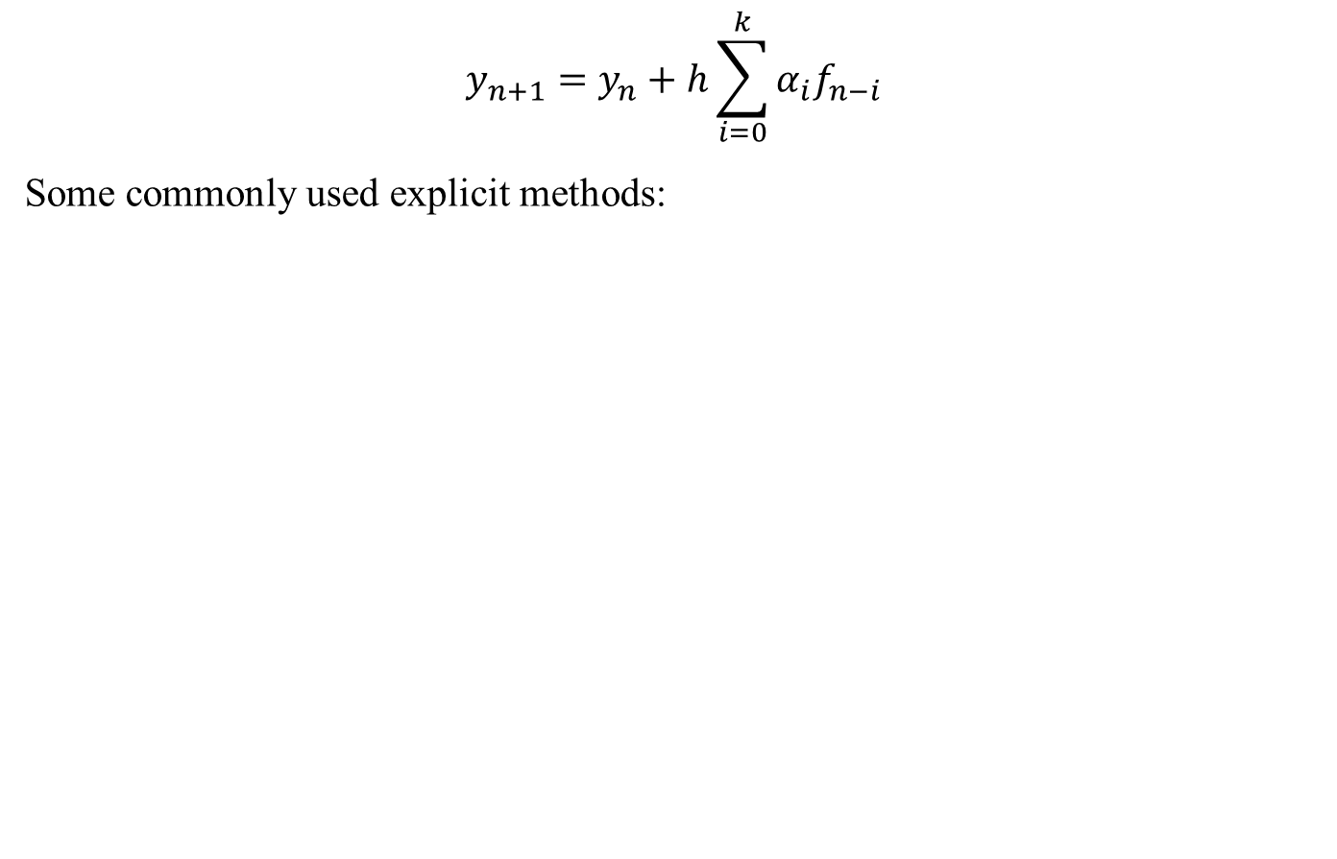
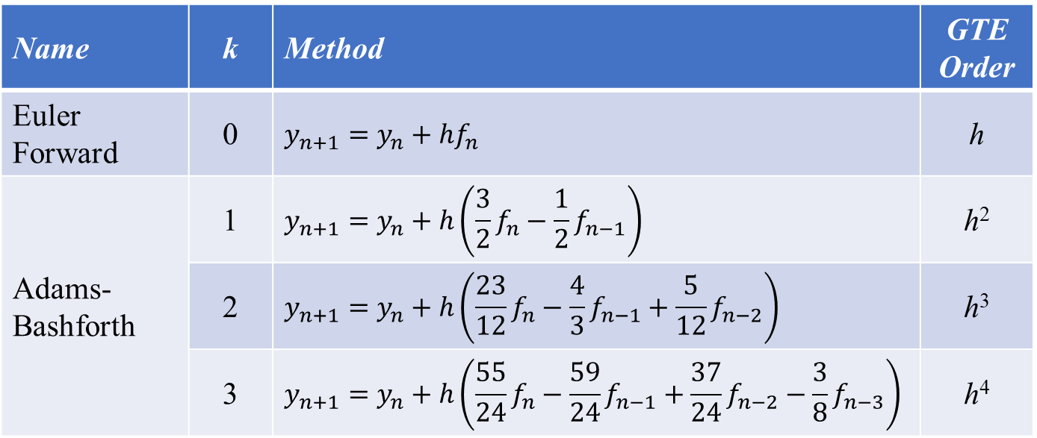
Multi-Step Methods: Explicit
,
$$y_{n+1}=y_{n}+h\sum_{i=0}^{k}{α_{i}f_{n−i}}$$
Some commonly used explicit methods:
Name | k | Method | GTE Order
Euler Forward | 0 | $$y_{n+1}=y_{n}+hf_{n}$$ | h
Adams-Bashforth | 1 | $$y_{n+1}=y_{n}+h\left(\frac{3}{2}f_{n}−\frac{1}{2}f_{n−1}\right)$$ | h²
 | 2 | $$y_{n+1}=y_{n}+h\left(\frac{23}{12}f_{n}−\frac{4}{3}f_{n−1}+\frac{5}{12}f_{n−2}\right)$$ | h³
 | 3 | $$y_{n+1}=y_{n}+h\left(\frac{55}{24}f_{n}−\frac{59}{24}f_{n−1}+\frac{37}{24}f_{n−2}−\frac{3}{8}f_{n−3}\right)$$ | h⁴

Slide 11
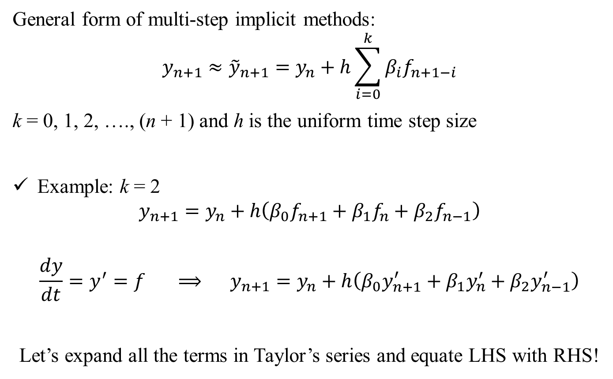
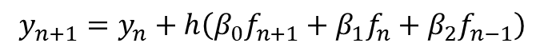
Multi-Step Methods: Implicit
,
General form of multi-step implicit methods:
$$y_{n+1}≈{\tilde{y}}_{n+1}=y_{n}+h\sum_{i=0}^{k}{β_{i}f_{n+1−i}}$$
k = 0, 1, 2, …., (n + 1) and h is the uniform time step size
Example: k = 2
$$y_{n+1}=y_{n}+h\left(β_{0}f_{n+1}+β_{1}f_{n}+β_{2}f_{n−1}\right)$$
$$\frac{dy}{dt}=y^{′}=f ⟹ y_{n+1}=y_{n}+h\left(β_{0}y_{n+1}^{′}+β_{1}y_{n}^{′}+β_{2}y_{n−1}^{′}\right)$$
Let’s expand all the terms in Taylor’s series and equate LHS with RHS!
$$y_{n+1}=y_{n}+h\left(β_{0}f_{n+1}+β_{1}f_{n}+β_{2}f_{n−1}\right)$$

Slide 12
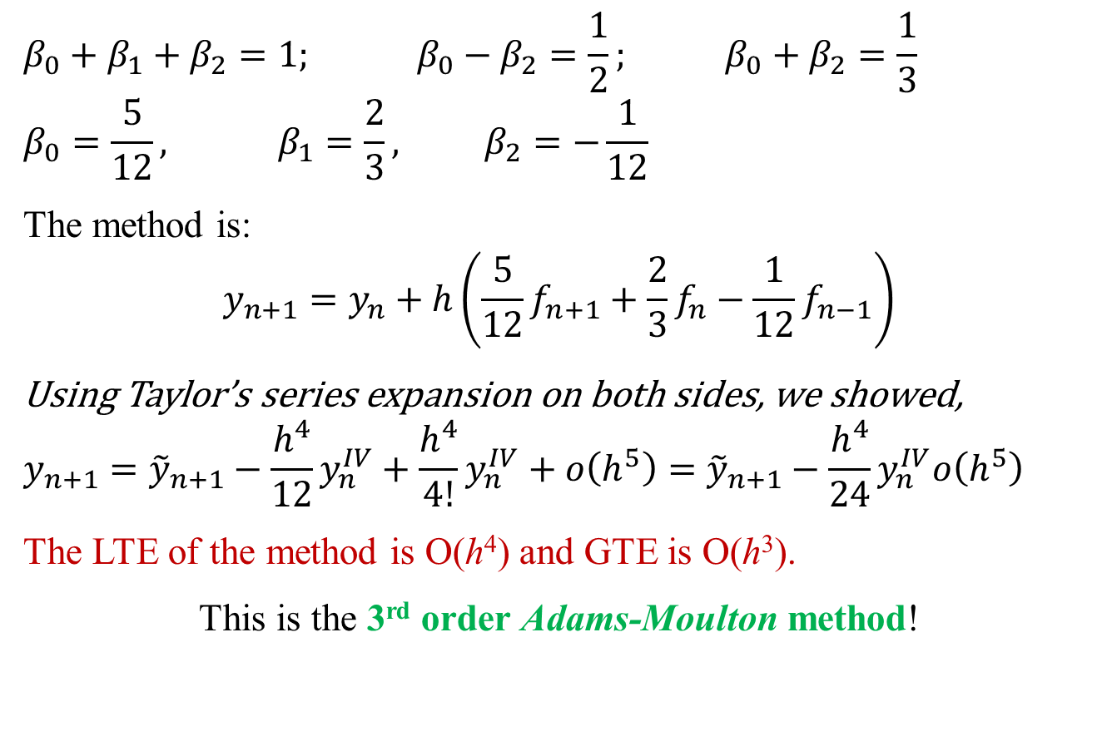
Multi-Step Methods: Implicit
,
$$β_{0}+β_{1}+β_{2}=1; β_{0}−β_{2}=\frac{1}{2}; β_{0}+β_{2}=\frac{1}{3}$$
$$β_{0}=\frac{5}{12}, β_{1}=\frac{2}{3}\text{,} β_{2}=−\frac{1}{12}$$
The method is:
$$y_{n+1}=y_{n}+h\left(\frac{5}{12}f_{n+1}+\frac{2}{3}f_{n}−\frac{1}{12}f_{n−1}\right)$$
Using Taylor’s series expansion on both sides, we showed,
$$y_{n+1}={\tilde{y}}_{n+1}−\frac{h^{4}}{12}y_{n}^{IV}+\frac{h^{4}}{4!}y_{n}^{IV}+ο\left(h^{5}\right)={\tilde{y}}_{n+1}−\frac{h^{4}}{24}y_{n}^{IV}ο\left(h^{5}\right)$$
The LTE of the method is O(h⁴) and GTE is O(h³).
This is the 3rd order Adams-Moulton method!

Slide 13
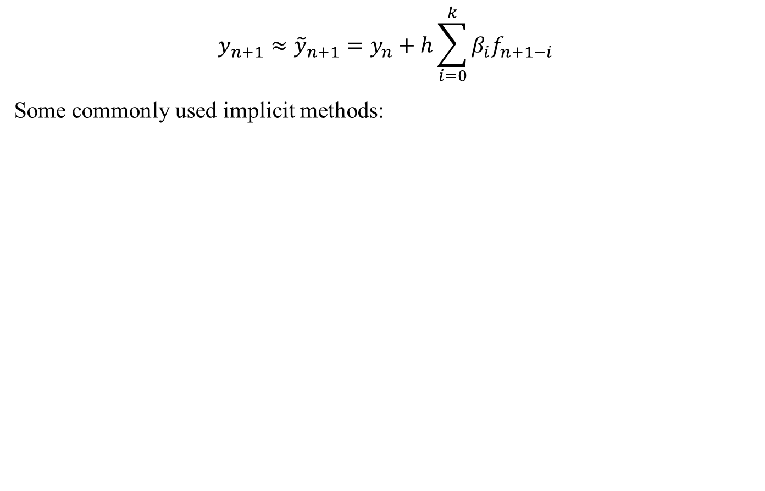
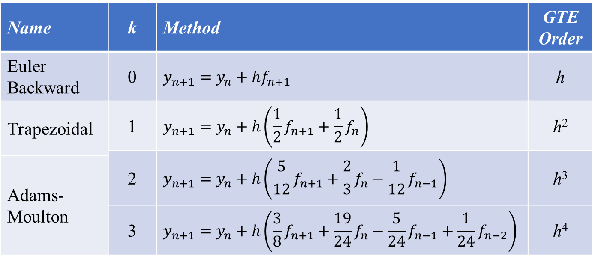
Multi-Step Methods: Implicit
,
$$y_{n+1}≈{\tilde{y}}_{n+1}=y_{n}+h\sum_{i=0}^{k}{β_{i}f_{n+1−i}}$$
Some commonly used implicit methods:
Name | k | Method | GTE Order
Euler Backward | 0 | $$y_{n+1}=y_{n}+hf_{n+1}$$ | h
Trapezoidal | 1 | $$y_{n+1}=y_{n}+h\left(\frac{1}{2}f_{n+1}+\frac{1}{2}f_{n}\right)$$ | h²
 | 2 | $$y_{n+1}=y_{n}+h\left(\frac{5}{12}f_{n+1}+\frac{2}{3}f_{n}−\frac{1}{12}f_{n−1}\right)$$ | h³
Adams-Moulton
 | 3 | $$y_{n+1}=y_{n}+h\left(\frac{3}{8}f_{n+1}+\frac{19}{24}f_{n}−\frac{5}{24}f_{n−1}+\frac{1}{24}f_{n−2}\right)$$ | h⁴

Slide 14
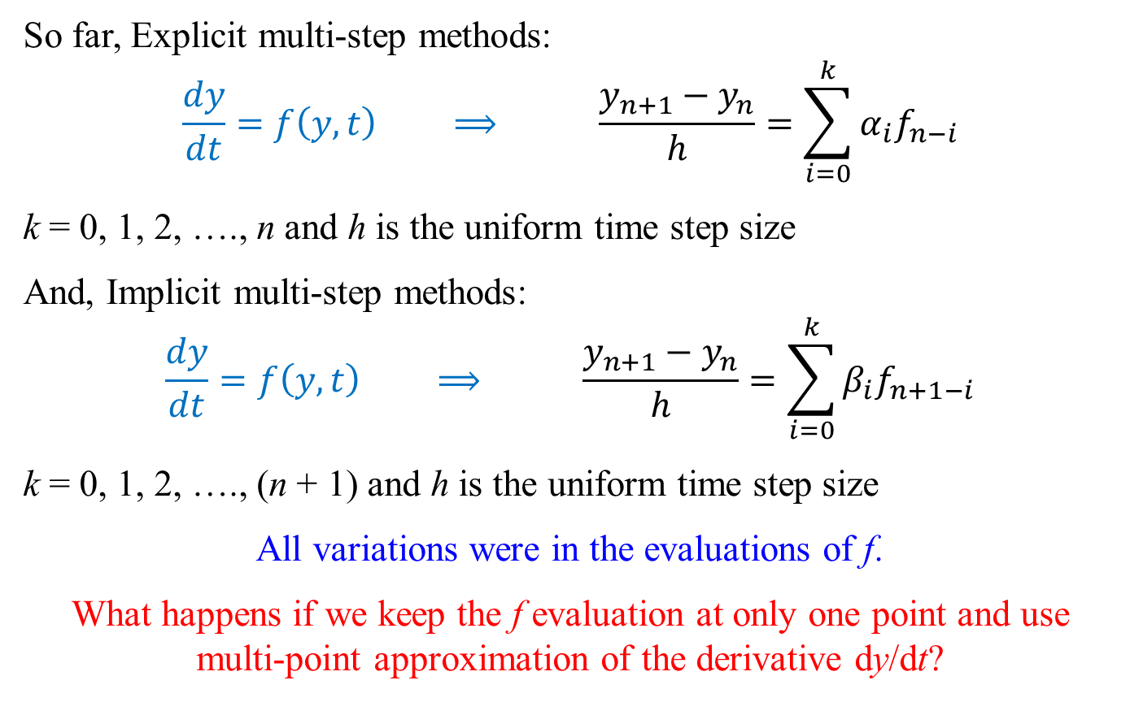
Backward Difference Formulae (BDF)
,
So far, Explicit multi-step methods:
$$\frac{dy}{dt}=f\left(y,t\right) ⟹ \frac{y_{n+1}−y_{n}}{h}=\sum_{i=0}^{k}{α_{i}f_{n−i}}$$
k = 0, 1, 2, …., n and h is the uniform time step size
And, Implicit multi-step methods:
$$\frac{dy}{dt}=f\left(y,t\right) ⟹ \frac{y_{n+1}−y_{n}}{h}=\sum_{i=0}^{k}{β_{i}f_{n+1−i}}$$
k = 0, 1, 2, …., (n + 1) and h is the uniform time step size
All variations were in the evaluations of f.
What happens if we keep the f evaluation at only one point and use multi-point approximation of the derivative dy/dt?

Slide 15
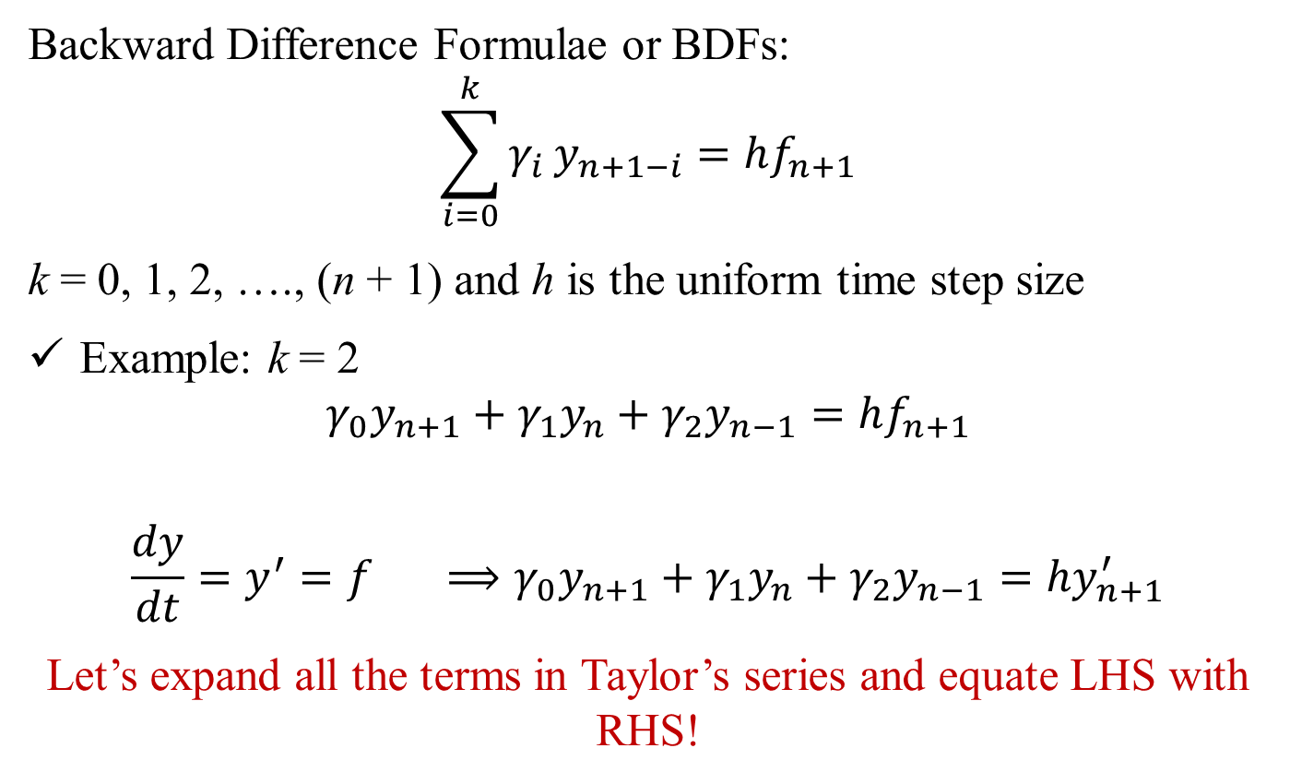
Backward Difference Formulae (BDF)
,
Backward Difference Formulae or BDFs:
$$\sum_{i=0}^{k}{γ_{i}}y_{n+1−i}=hf_{n+1}$$
k = 0, 1, 2, …., (n + 1) and h is the uniform time step size
Example: k = 2
$$γ_{0}y_{n+1}+γ_{1}y_{n}+γ_{2}y_{n−1}=hf_{n+1}$$
$$\frac{dy}{dt}=y^{′}=f ⟹γ_{0}y_{n+1}+γ_{1}y_{n}+γ_{2}y_{n−1}=hy_{n+1}^{′}$$
Let’s expand all the terms in Taylor’s series and equate LHS with RHS!

Slide 16
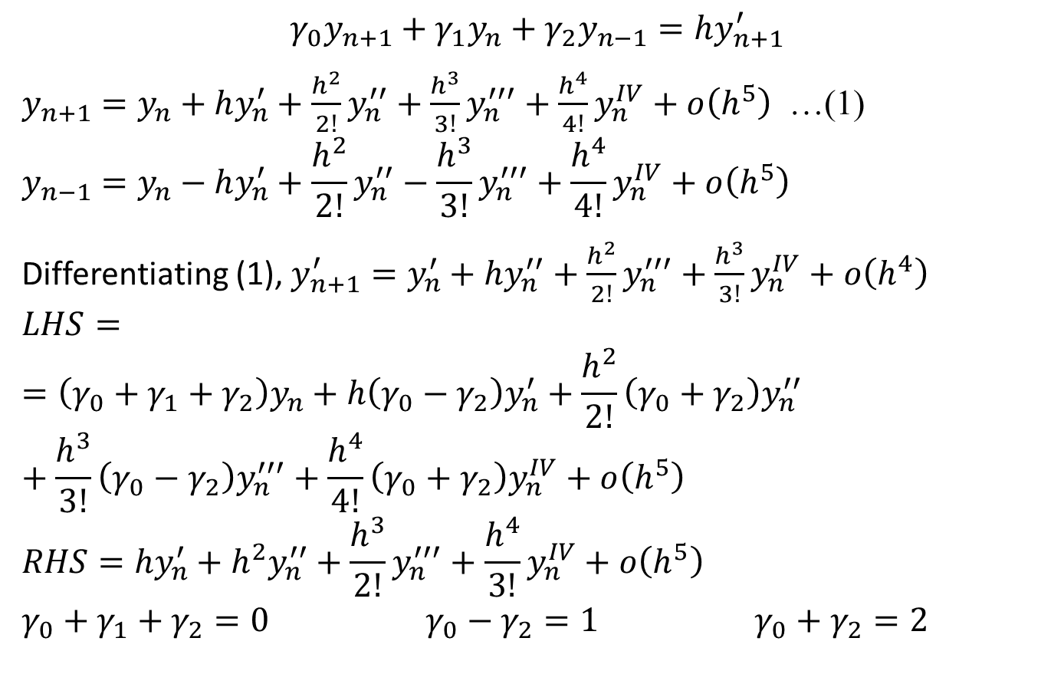
Backward Difference Formulae (BDF)
,
$$γ_{0}y_{n+1}+γ_{1}y_{n}+γ_{2}y_{n−1}=hy_{n+1}^{′}$$
$y_{n+1}=y_{n}+hy_{n}^{′}+\frac{h^{2}}{2!}y_{n}^{′′}+\frac{h^{3}}{3!}y_{n}^{′′′}+\frac{h^{4}}{4!}y_{n}^{IV}+ο\left(h^{5}\right)$ …(1)
$$y_{n−1}=y_{n}−hy_{n}^{′}+\frac{h^{2}}{2!}y_{n}^{′′}−\frac{h^{3}}{3!}y_{n}^{′′′}+\frac{h^{4}}{4!}y_{n}^{IV}+ο\left(h^{5}\right)$$
Differentiating (1), $y_{n+1}^{′}=y_{n}^{′}+hy_{n}^{′′}+\frac{h^{2}}{2!}y_{n}^{′′′}+\frac{h^{3}}{3!}y_{n}^{IV}+ο\left(h^{4}\right)$
$$LHS==\left(γ_{0}+γ_{1}+γ_{2}\right)y_{n}+h\left(γ_{0}−γ_{2}\right)y_{n}^{′}+\frac{h^{2}}{2!}\left(γ_{0}+γ_{2}\right)y_{n}^{′′}+\frac{h^{3}}{3!}\left(γ_{0}−γ_{2}\right)y_{n}^{′′′}+\frac{h^{4}}{4!}\left(γ_{0}+γ_{2}\right)y_{n}^{IV}+ο\left(h^{5}\right)$$
$$RHS={hy}_{n}^{′}+h^{2}y_{n}^{′′}+\frac{h^{3}}{2!}y_{n}^{′′′}+\frac{h^{4}}{3!}y_{n}^{IV}+ο\left(h^{5}\right)$$
$$γ_{0}+γ_{1}+γ_{2}=0 γ_{0}−γ_{2}=1 γ_{0}+γ_{2}=2$$

Slide 17
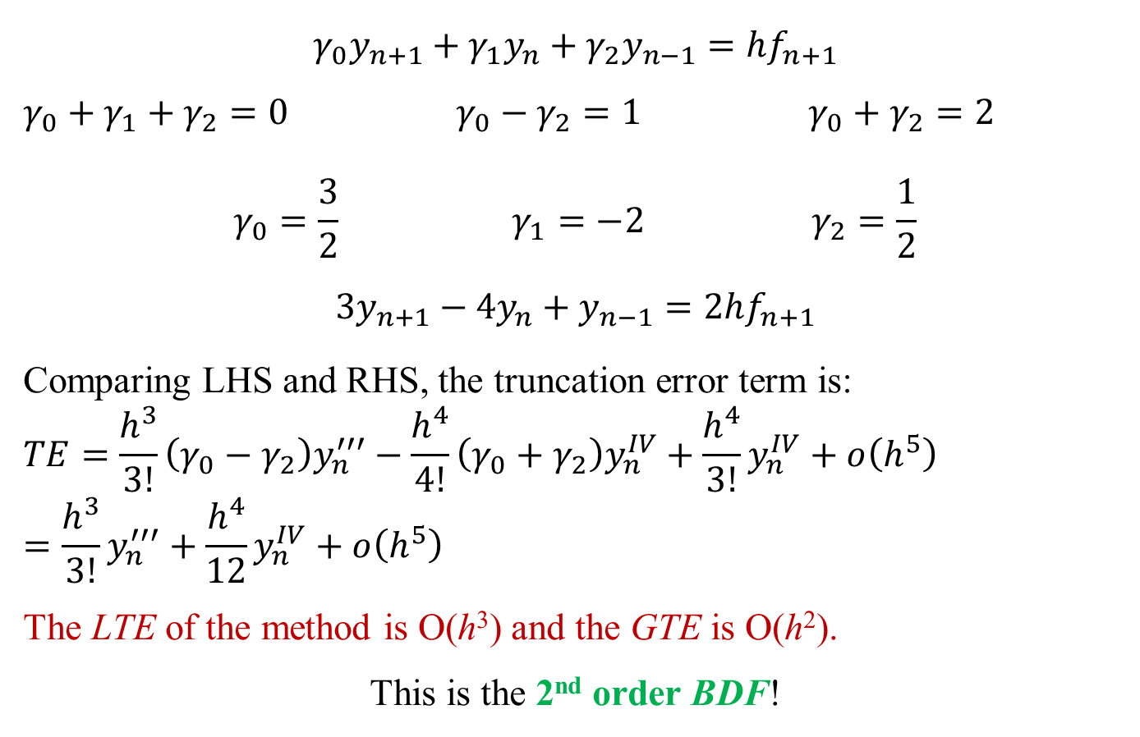
Backward Difference Formulae (BDF)
,
$$γ_{0}y_{n+1}+γ_{1}y_{n}+γ_{2}y_{n−1}=hf_{n+1}$$
$$γ_{0}+γ_{1}+γ_{2}=0 γ_{0}−γ_{2}=1 γ_{0}+γ_{2}=2$$
$$γ_{0}=\frac{3}{2} γ_{1}=−2 γ_{2}=\frac{1}{2}$$
$$3y_{n+1}−4y_{n}+y_{n−1}=2hf_{n+1}$$
Comparing LHS and RHS, the truncation error term is:
$$TE=\frac{h^{3}}{3!}\left(γ_{0}−γ_{2}\right)y_{n}^{′′′}−\frac{h^{4}}{4!}\left(γ_{0}+γ_{2}\right)y_{n}^{IV}+\frac{h^{4}}{3!}y_{n}^{IV}+ο\left(h^{5}\right)=\frac{h^{3}}{3!}y_{n}^{′′′}+\frac{h^{4}}{12}y_{n}^{IV}+ο\left(h^{5}\right)$$
The LTE of the method is O(h³) and the GTE is O(h²).
This is the 2nd order BDF!

Slide 18
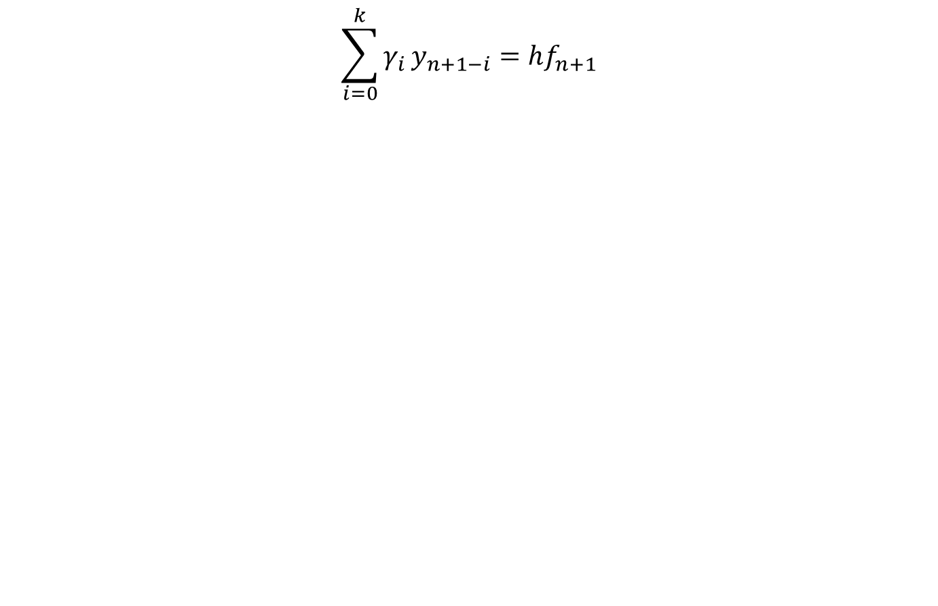
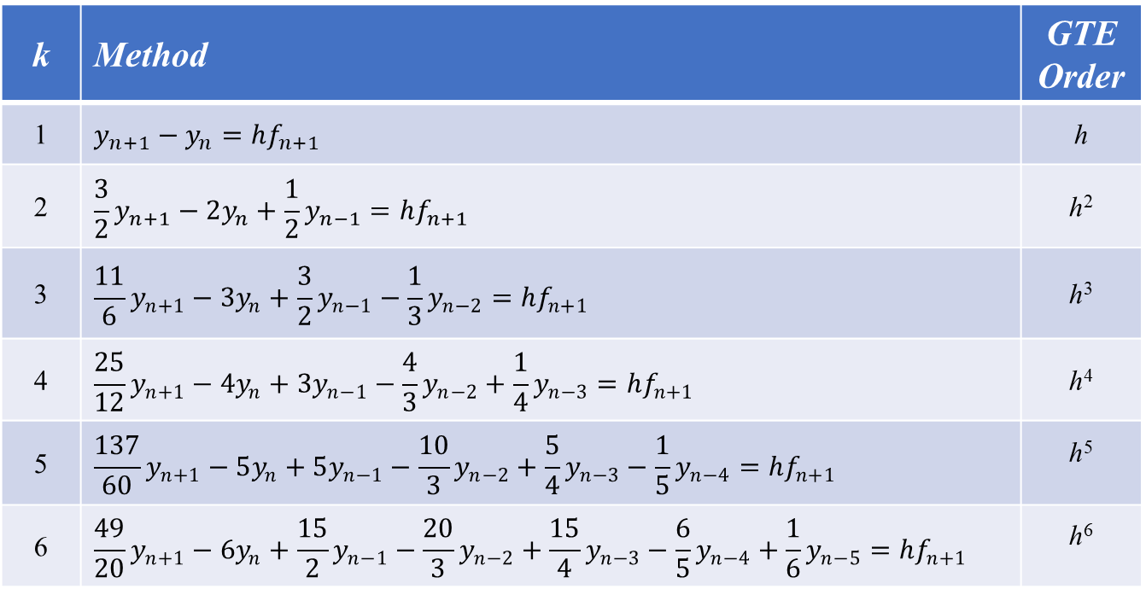
Backward Difference Formulae (BDF)
,
$$\sum_{i=0}^{k}{γ_{i}}y_{n+1−i}=hf_{n+1}$$
k | Method | GTE Order
1 | $$y_{n+1}−y_{n}=hf_{n+1}$$ | h
2 | $$\frac{3}{2}y_{n+1}−2y_{n}+\frac{1}{2}y_{n−1}=hf_{n+1}$$ | h²
3 | $$\frac{11}{6}y_{n+1}−3y_{n}+\frac{3}{2}y_{n−1}−\frac{1}{3}y_{n−2}=hf_{n+1}$$ | h³
4 | $$\frac{25}{12}y_{n+1}−4y_{n}+3y_{n−1}−\frac{4}{3}y_{n−2}+\frac{1}{4}y_{n−3}=hf_{n+1}$$ | h⁴
5 | $$\frac{137}{60}y_{n+1}−5y_{n}+5y_{n−1}−\frac{10}{3}y_{n−2}+\frac{5}{4}y_{n−3}−\frac{1}{5}y_{n−4}=hf_{n+1}$$ | h⁵
6 | $$\frac{49}{20}y_{n+1}−6y_{n}+\frac{15}{2}y_{n−1}−\frac{20}{3}y_{n−2}+\frac{15}{4}y_{n−3}−\frac{6}{5}y_{n−4}+\frac{1}{6}y_{n−5}=hf_{n+1}$$ | h⁶

Slide 19
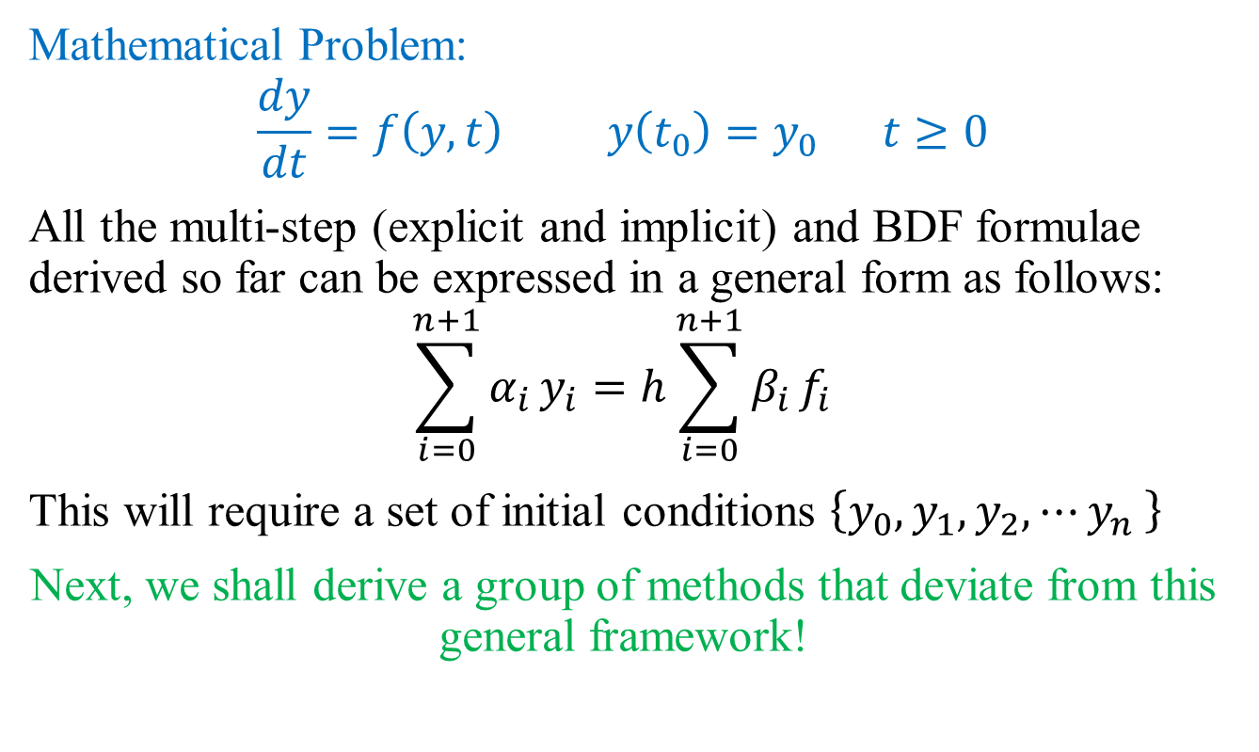
Generalized Multi-Step Methods
Mathematical Problem:
$$\frac{dy}{dt}=f\left(y,t\right) y\left(t_{0}\right)=y_{0} t≥0$$
All the multi-step (explicit and implicit) and BDF formulae derived so far can be expressed in a general form as follows:
$$\sum_{i=0}^{n+1}{α_{i}}y_{i}=h\sum_{i=0}^{n+1}{β_{i}}f_{i}$$
This will require a set of initial conditions $\left\{y_{0},y_{1},y_{2},⋯y_{n} \right\}$
Next, we shall derive a group of methods that deviate from this general framework!

Slide 20
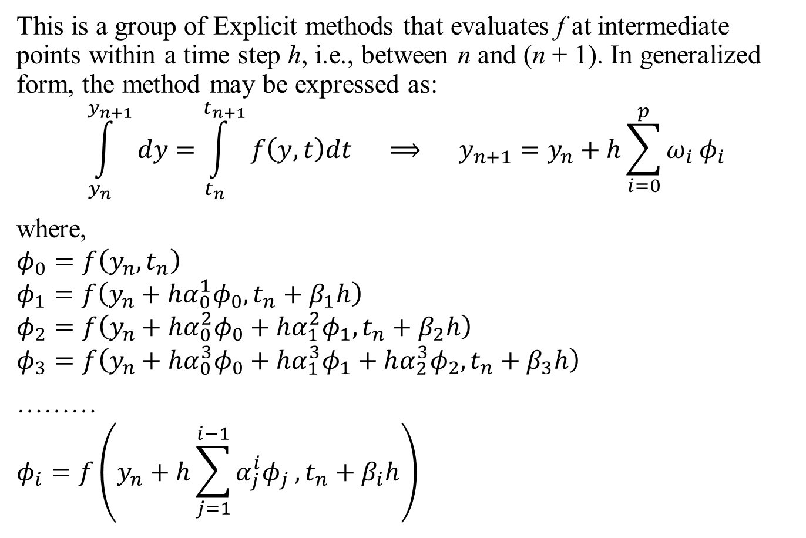
Runge-Kutta (R-K) Methods
,
This is a group of Explicit methods that evaluates f at intermediate points within a time step h, i.e., between n and (n + 1). In generalized form, the method may be expressed as:
$$\int_{y_{n}}^{y_{n+1}}{dy}=\int_{t_{n}}^{t_{n+1}}{f\left(y,t\right)dt} ⟹ y_{n+1}=y_{n}+h\sum_{i=0}^{p}{ω_{i}}φ_{i}$$
where,
$$φ_{0}=f\left(y_{n},t_{n}\right)$$
$$φ_{1}=f\left(y_{n}+hα_{0}^{1}φ_{0},t_{n}+β_{1}h\right)$$
$$φ_{2}=f\left(y_{n}+hα_{0}^{2}φ_{0}+hα_{1}^{2}φ_{1},t_{n}+β_{2}h\right)$$
$$φ_{3}=f\left(y_{n}+hα_{0}^{3}φ_{0}+hα_{1}^{3}φ_{1}+hα_{2}^{3}φ_{2},t_{n}+β_{3}h\right)$$
………
$$φ_{i}=f\left(y_{n}+h\sum_{j=1}^{i−1}{α_{j}^{i}φ_{j}},t_{n}+β_{i}h\right)$$

Slide 21
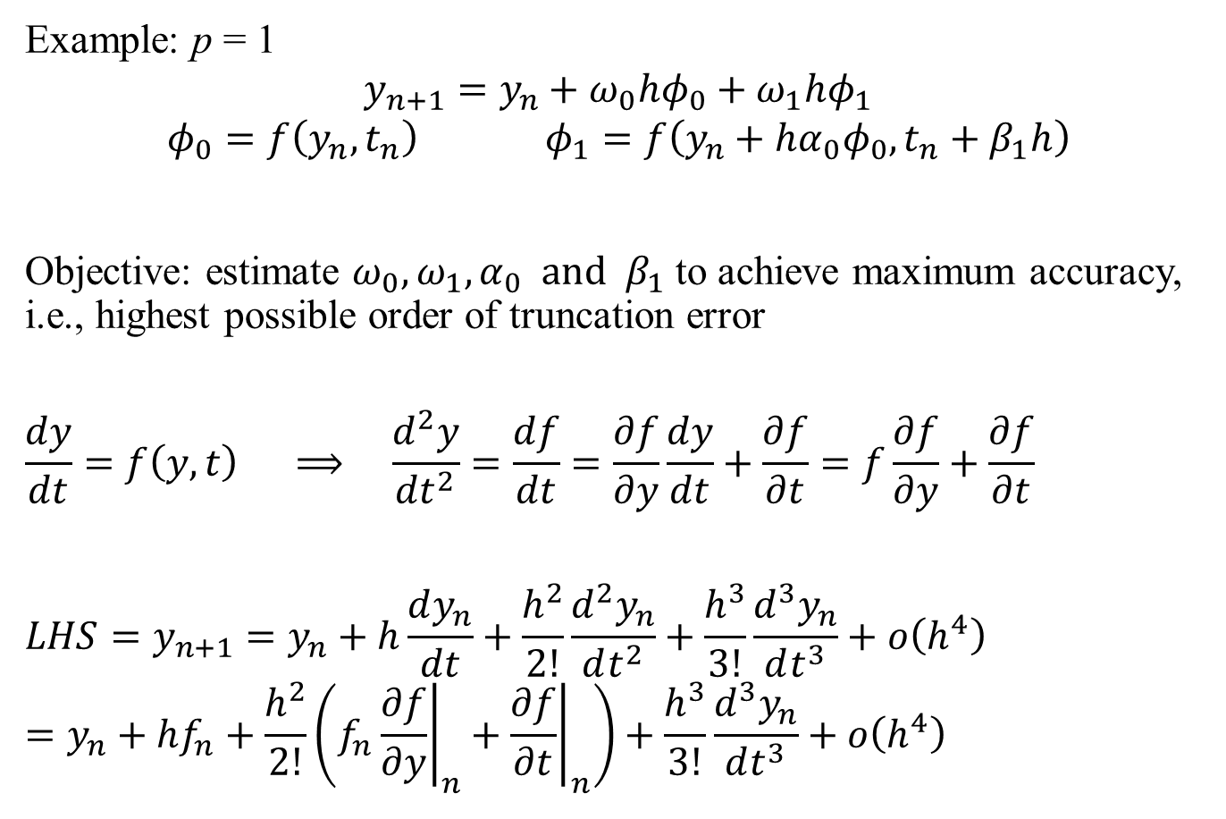
Runge-Kutta (R-K) Methods
,
Example: p = 1
$$y_{n+1}=y_{n}+ω_{0}hφ_{0}+ω_{1}hφ_{1}$$
$$φ_{0}=f\left(y_{n},t_{n}\right) φ_{1}=f\left(y_{n}+hα_{0}φ_{0},t_{n}+β_{1}h\right)$$
Objective: estimate $ω_{0},ω_{1},α_{0} and β_{1}$ to achieve maximum accuracy, i.e., highest possible order of truncation error
$$\frac{dy}{dt}=f\left(y,t\right) ⟹ \frac{d^{2}y}{dt^{2}}=\frac{df}{dt}=\frac{∂f}{∂y}\frac{dy}{dt}+\frac{∂f}{∂t}=f\frac{∂f}{∂y}+\frac{∂f}{∂t}$$
$$LHS=y_{n+1}=y_{n}+h\frac{dy_{n}}{dt}+\frac{h^{2}}{2!}\frac{d^{2}y_{n}}{dt^{2}}+\frac{h^{3}}{3!}\frac{d^{3}y_{n}}{dt^{3}}+ο\left(h^{4}\right)=y_{n}+hf_{n}+\frac{h^{2}}{2!}\left(f_{n}{\left.\frac{∂f}{∂y}\right|}_{n}+{\left.\frac{∂f}{∂t}\right|}_{n}\right)+\frac{h^{3}}{3!}\frac{d^{3}y_{n}}{dt^{3}}+ο\left(h^{4}\right)$$

Slide 22
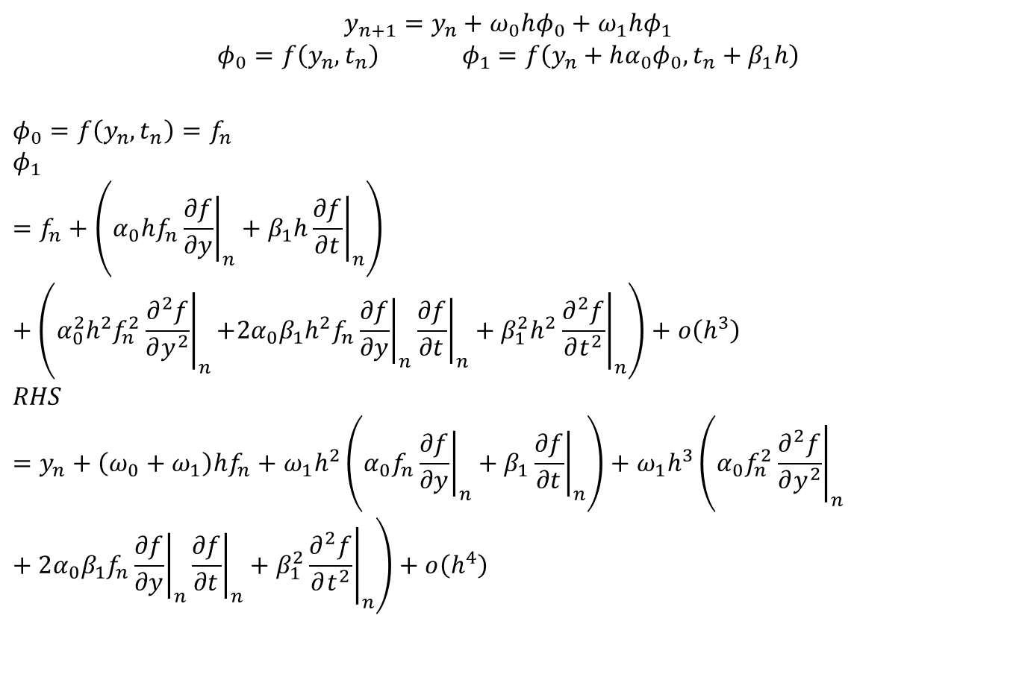
Runge-Kutta (R-K) Methods
,
$$y_{n+1}=y_{n}+ω_{0}hφ_{0}+ω_{1}hφ_{1}$$
$$φ_{0}=f\left(y_{n},t_{n}\right) φ_{1}=f\left(y_{n}+hα_{0}φ_{0},t_{n}+β_{1}h\right)$$
$$φ_{0}=f\left(y_{n},t_{n}\right)=f_{n}$$
$$φ_{1}=f_{n}+\left.\left(α_{0}hf_{n}{\left.\frac{∂f}{∂y}\right|}_{n}+β_{1}h{\left.\frac{∂f}{∂t}\right|}_{n}\right.\right)+\left(α_{0}^{2}h^{2}f_{n}^{2}{\left.\frac{∂^{2}f}{∂y^{2}}\right|}_{n}\right.\left.+2α_{0}β_{1}h^{2}f_{n}{\left.\frac{∂f}{∂y}\right|}_{n}{\left.\frac{∂f}{∂t}\right|}_{n}+β_{1}^{2}h^{2}{\left.\frac{∂^{2}f}{∂t^{2}}\right|}_{n}\right)+ο\left(h^{3}\right)$$
$$RHS=y_{n}+\left(ω_{0}+ω_{1}\right)hf_{n}+ω_{1}h^{2}\left.\left(α_{0}f_{n}{\left.\frac{∂f}{∂y}\right|}_{n}+β_{1}{\left.\frac{∂f}{∂t}\right|}_{n}\right.\right)+ω_{1}h^{3}\left(α_{0}f_{n}^{2}{\left.\frac{∂^{2}f}{∂y^{2}}\right|}_{n}\right.+2α_{0}β_{1}f_{n}{\left.\frac{∂f}{∂y}\right|}_{n}{\left.\frac{∂f}{∂t}\right|}_{n}+\left.β_{1}^{2}{\left.\frac{∂^{2}f}{∂t^{2}}\right|}_{n}\right)+ο\left(h^{4}\right)$$

Slide 23
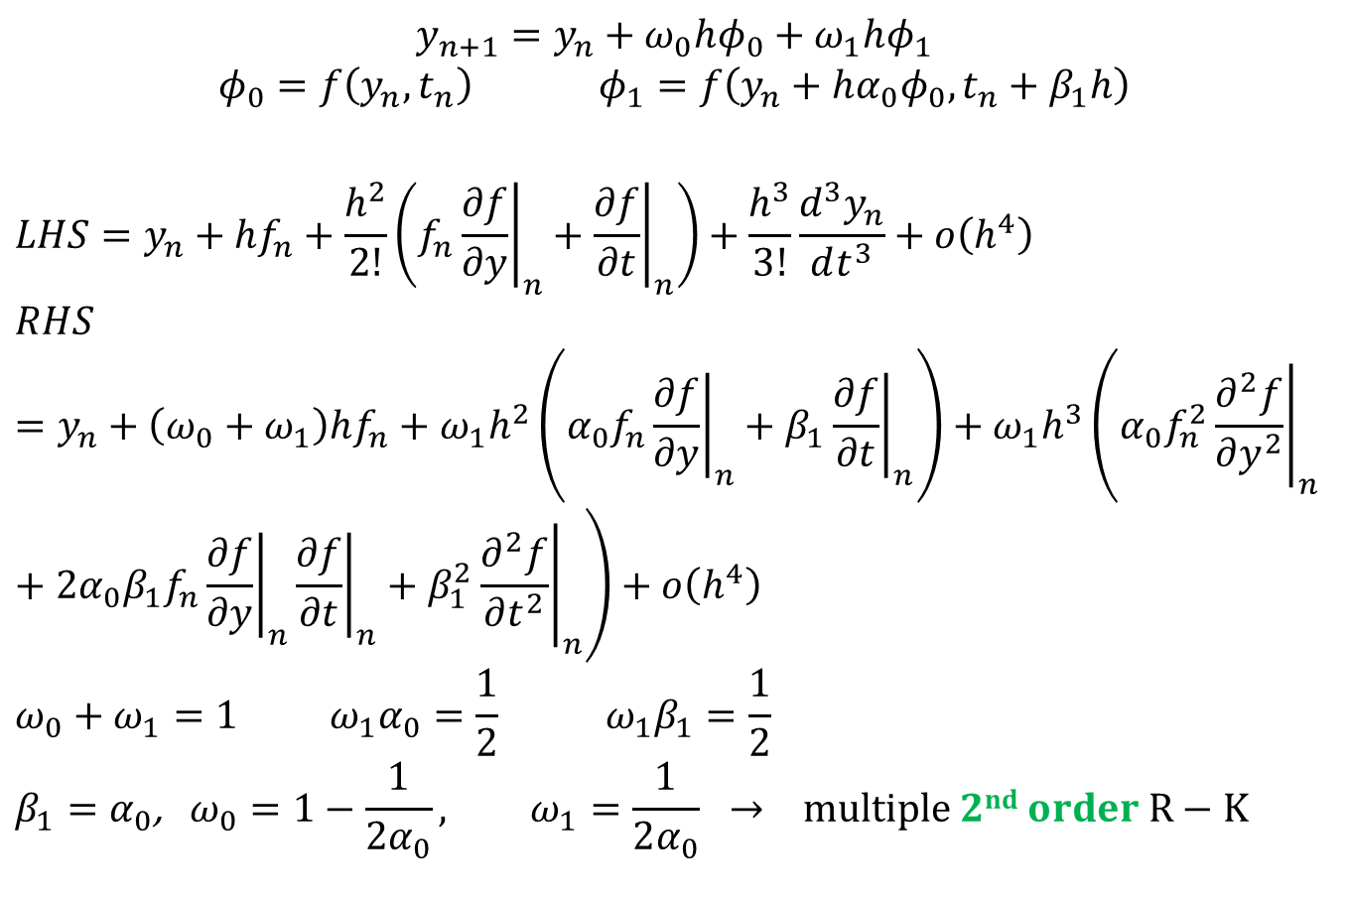
Runge-Kutta (R-K) Methods
,
$$y_{n+1}=y_{n}+ω_{0}hφ_{0}+ω_{1}hφ_{1}$$
$$φ_{0}=f\left(y_{n},t_{n}\right) φ_{1}=f\left(y_{n}+hα_{0}φ_{0},t_{n}+β_{1}h\right)$$
$$LHS=y_{n}+hf_{n}+\frac{h^{2}}{2!}\left(f_{n}{\left.\frac{∂f}{∂y}\right|}_{n}+{\left.\frac{∂f}{∂t}\right|}_{n}\right)+\frac{h^{3}}{3!}\frac{d^{3}y_{n}}{dt^{3}}+ο\left(h^{4}\right)$$
$$RHS=y_{n}+\left(ω_{0}+ω_{1}\right)hf_{n}+ω_{1}h^{2}\left.\left(α_{0}f_{n}{\left.\frac{∂f}{∂y}\right|}_{n}+β_{1}{\left.\frac{∂f}{∂t}\right|}_{n}\right.\right)+ω_{1}h^{3}\left(α_{0}f_{n}^{2}{\left.\frac{∂^{2}f}{∂y^{2}}\right|}_{n}\right.+2α_{0}β_{1}f_{n}{\left.\frac{∂f}{∂y}\right|}_{n}{\left.\frac{∂f}{∂t}\right|}_{n}+\left.β_{1}^{2}{\left.\frac{∂^{2}f}{∂t^{2}}\right|}_{n}\right)+ο\left(h^{4}\right)$$
$$ω_{0}+ω_{1}=1 ω_{1}α_{0}=\frac{1}{2} ω_{1}β_{1}=\frac{1}{2}$$
$$β_{1}=α_{0}\text{, }ω_{0}=1−\frac{1}{2α_{0}}, ω_{1}=\frac{1}{2α_{0}} → multiple 2nd order R−K$$

Slide 24
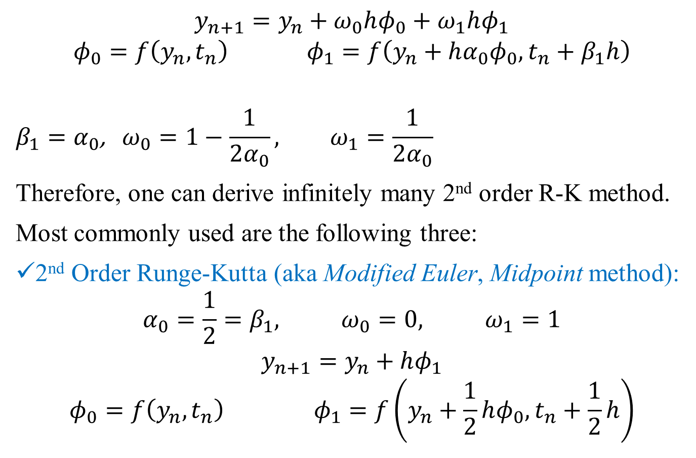
Runge-Kutta (R-K) Methods
,
$$y_{n+1}=y_{n}+ω_{0}hφ_{0}+ω_{1}hφ_{1}$$
$$φ_{0}=f\left(y_{n},t_{n}\right) φ_{1}=f\left(y_{n}+hα_{0}φ_{0},t_{n}+β_{1}h\right)$$
$$β_{1}=α_{0}\text{, }ω_{0}=1−\frac{1}{2α_{0}}, ω_{1}=\frac{1}{2α_{0}}$$
Therefore, one can derive infinitely many 2nd order R-K method.
Most commonly used are the following three:
2nd Order Runge-Kutta (aka Modified Euler, Midpoint method):
$$α_{0}=\frac{1}{2}=β_{1}, ω_{0}=0, ω_{1}=1$$
$$y_{n+1}=y_{n}+hφ_{1}$$
$$φ_{0}=f\left(y_{n},t_{n}\right) φ_{1}=f\left(y_{n}+\frac{1}{2}hφ_{0},t_{n}+\frac{1}{2}h\right)$$

Slide 25
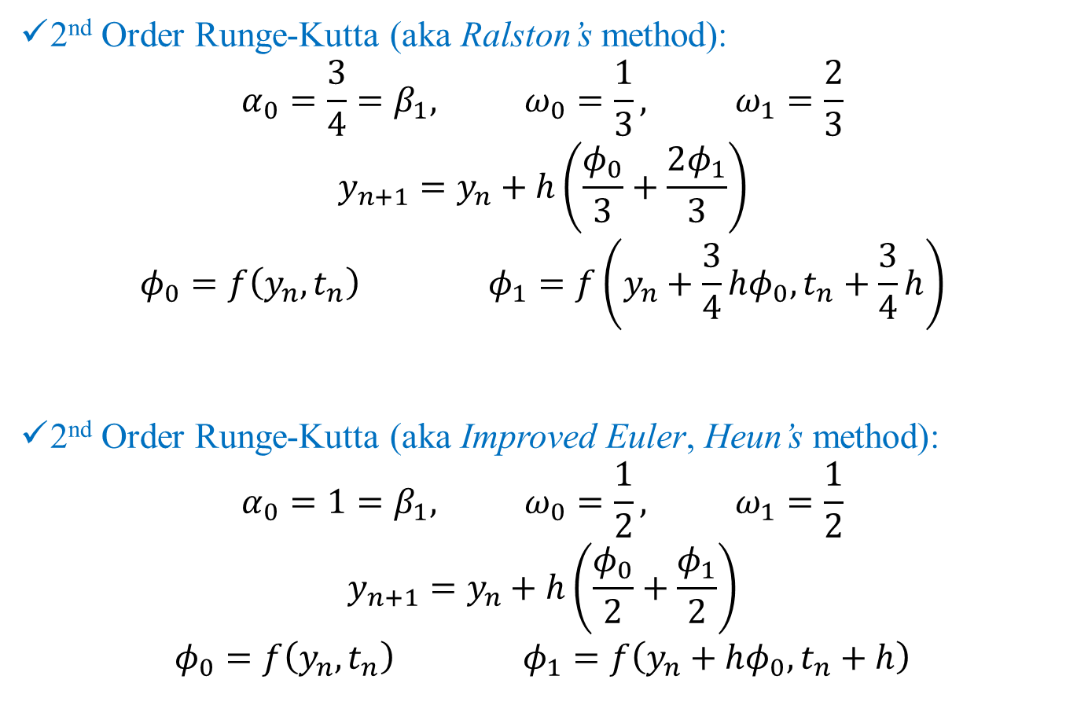
Runge-Kutta (R-K) Methods
,
2nd Order Runge-Kutta (aka Ralston’s method):
$$α_{0}=\frac{3}{4}=β_{1}, ω_{0}=\frac{1}{3}, ω_{1}=\frac{2}{3}$$
$$y_{n+1}=y_{n}+h\left(\frac{φ_{0}}{3}+\frac{2φ_{1}}{3}\right)$$
$$φ_{0}=f\left(y_{n},t_{n}\right) φ_{1}=f\left(y_{n}+\frac{3}{4}hφ_{0},t_{n}+\frac{3}{4}h\right)$$
2nd Order Runge-Kutta (aka Improved Euler, Heun’s method):
$$α_{0}=1=β_{1}, ω_{0}=\frac{1}{2}, ω_{1}=\frac{1}{2}$$
$$y_{n+1}=y_{n}+h\left(\frac{φ_{0}}{2}+\frac{φ_{1}}{2}\right)$$
$$φ_{0}=f\left(y_{n},t_{n}\right) φ_{1}=f\left(y_{n}+hφ_{0},t_{n}+h\right)$$

Slide 26
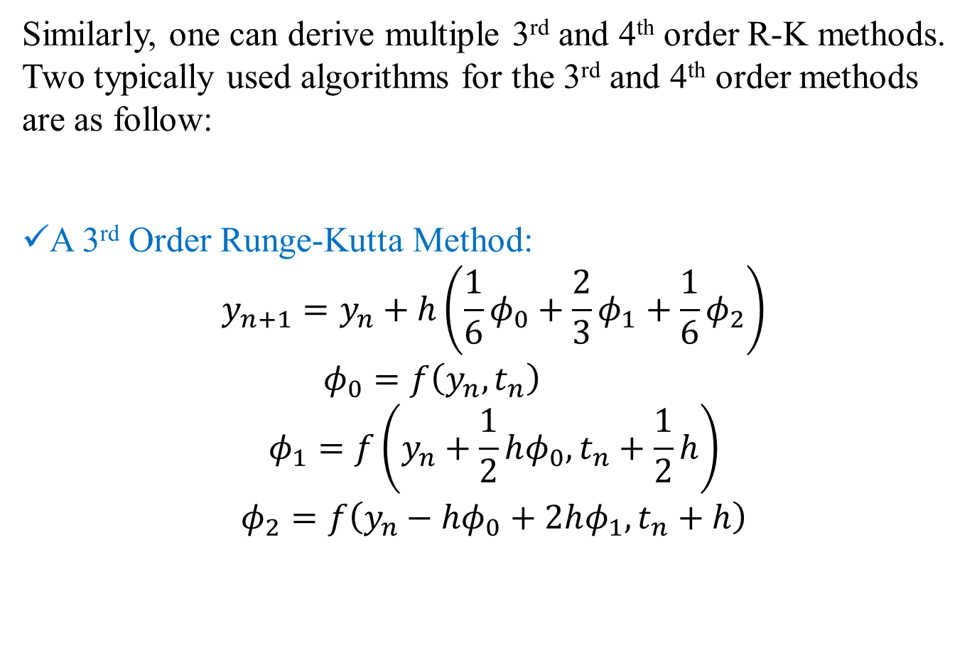
Runge-Kutta (R-K) Methods
,
Similarly, one can derive multiple 3rd and 4th order R-K methods. Two typically used algorithms for the 3rd and 4th order methods are as follow:
A 3rd Order Runge-Kutta Method:
$$y_{n+1}=y_{n}+h\left(\frac{1}{6}φ_{0}+\frac{2}{3}φ_{1}+\frac{1}{6}φ_{2}\right)$$
$$φ_{0}=f\left(y_{n},t_{n}\right)$$
$$φ_{1}=f\left(y_{n}+\frac{1}{2}hφ_{0},t_{n}+\frac{1}{2}h\right)$$
$$φ_{2}=f\left(y_{n}−hφ_{0}+2hφ_{1},t_{n}+h\right)$$

Slide 27
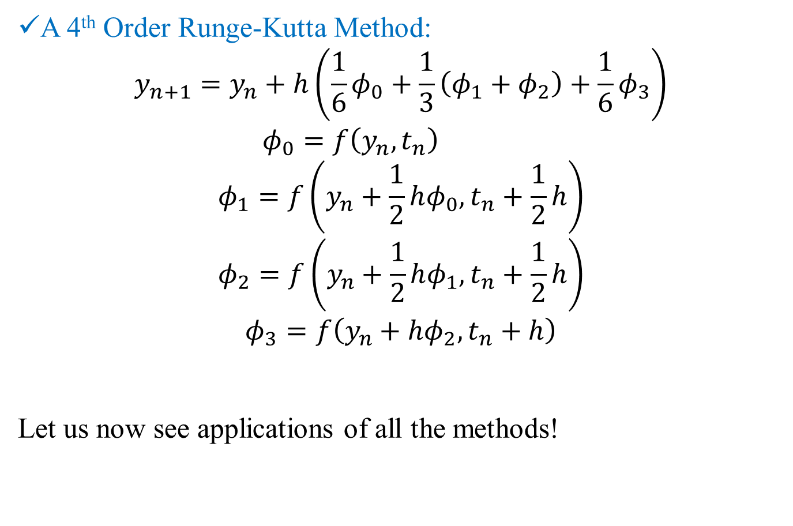
Runge-Kutta (R-K) Methods
,
A 4th Order Runge-Kutta Method:
$$y_{n+1}=y_{n}+h\left(\frac{1}{6}φ_{0}+\frac{1}{3}\left(φ_{1}+φ_{2}\right)+\frac{1}{6}φ_{3}\right)$$
$$φ_{0}=f\left(y_{n},t_{n}\right)$$
$$φ_{1}=f\left(y_{n}+\frac{1}{2}hφ_{0},t_{n}+\frac{1}{2}h\right)$$
$$φ_{2}=f\left(y_{n}+\frac{1}{2}hφ_{1},t_{n}+\frac{1}{2}h\right)$$
$$φ_{3}=f\left(y_{n}+hφ_{2},t_{n}+h\right)$$
Let us now see applications of all the methods!

Slide 28
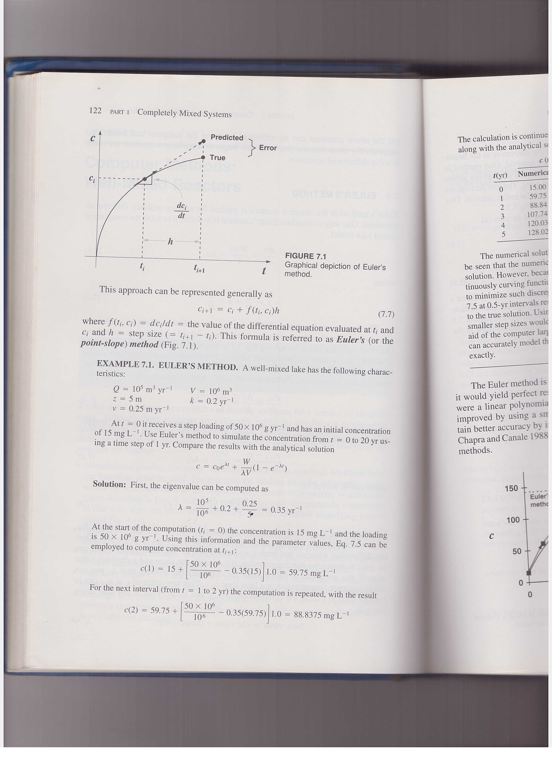
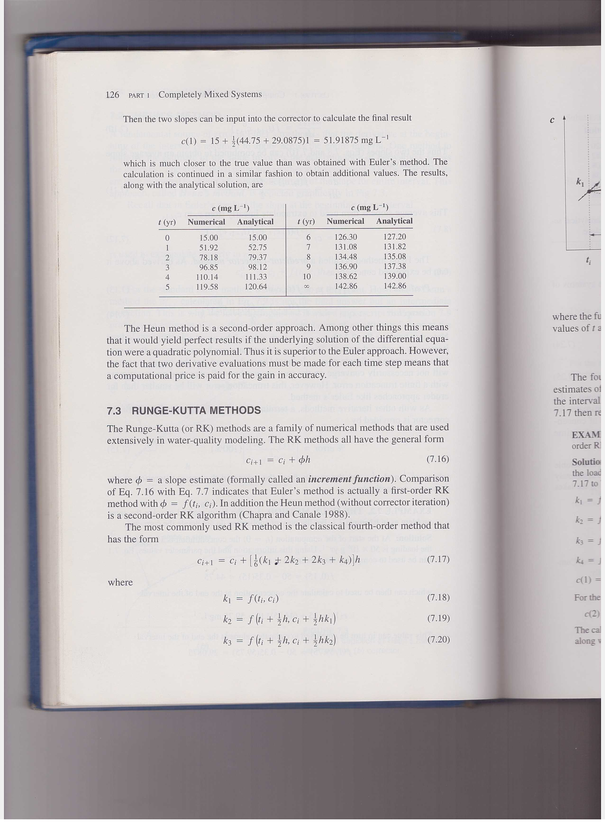
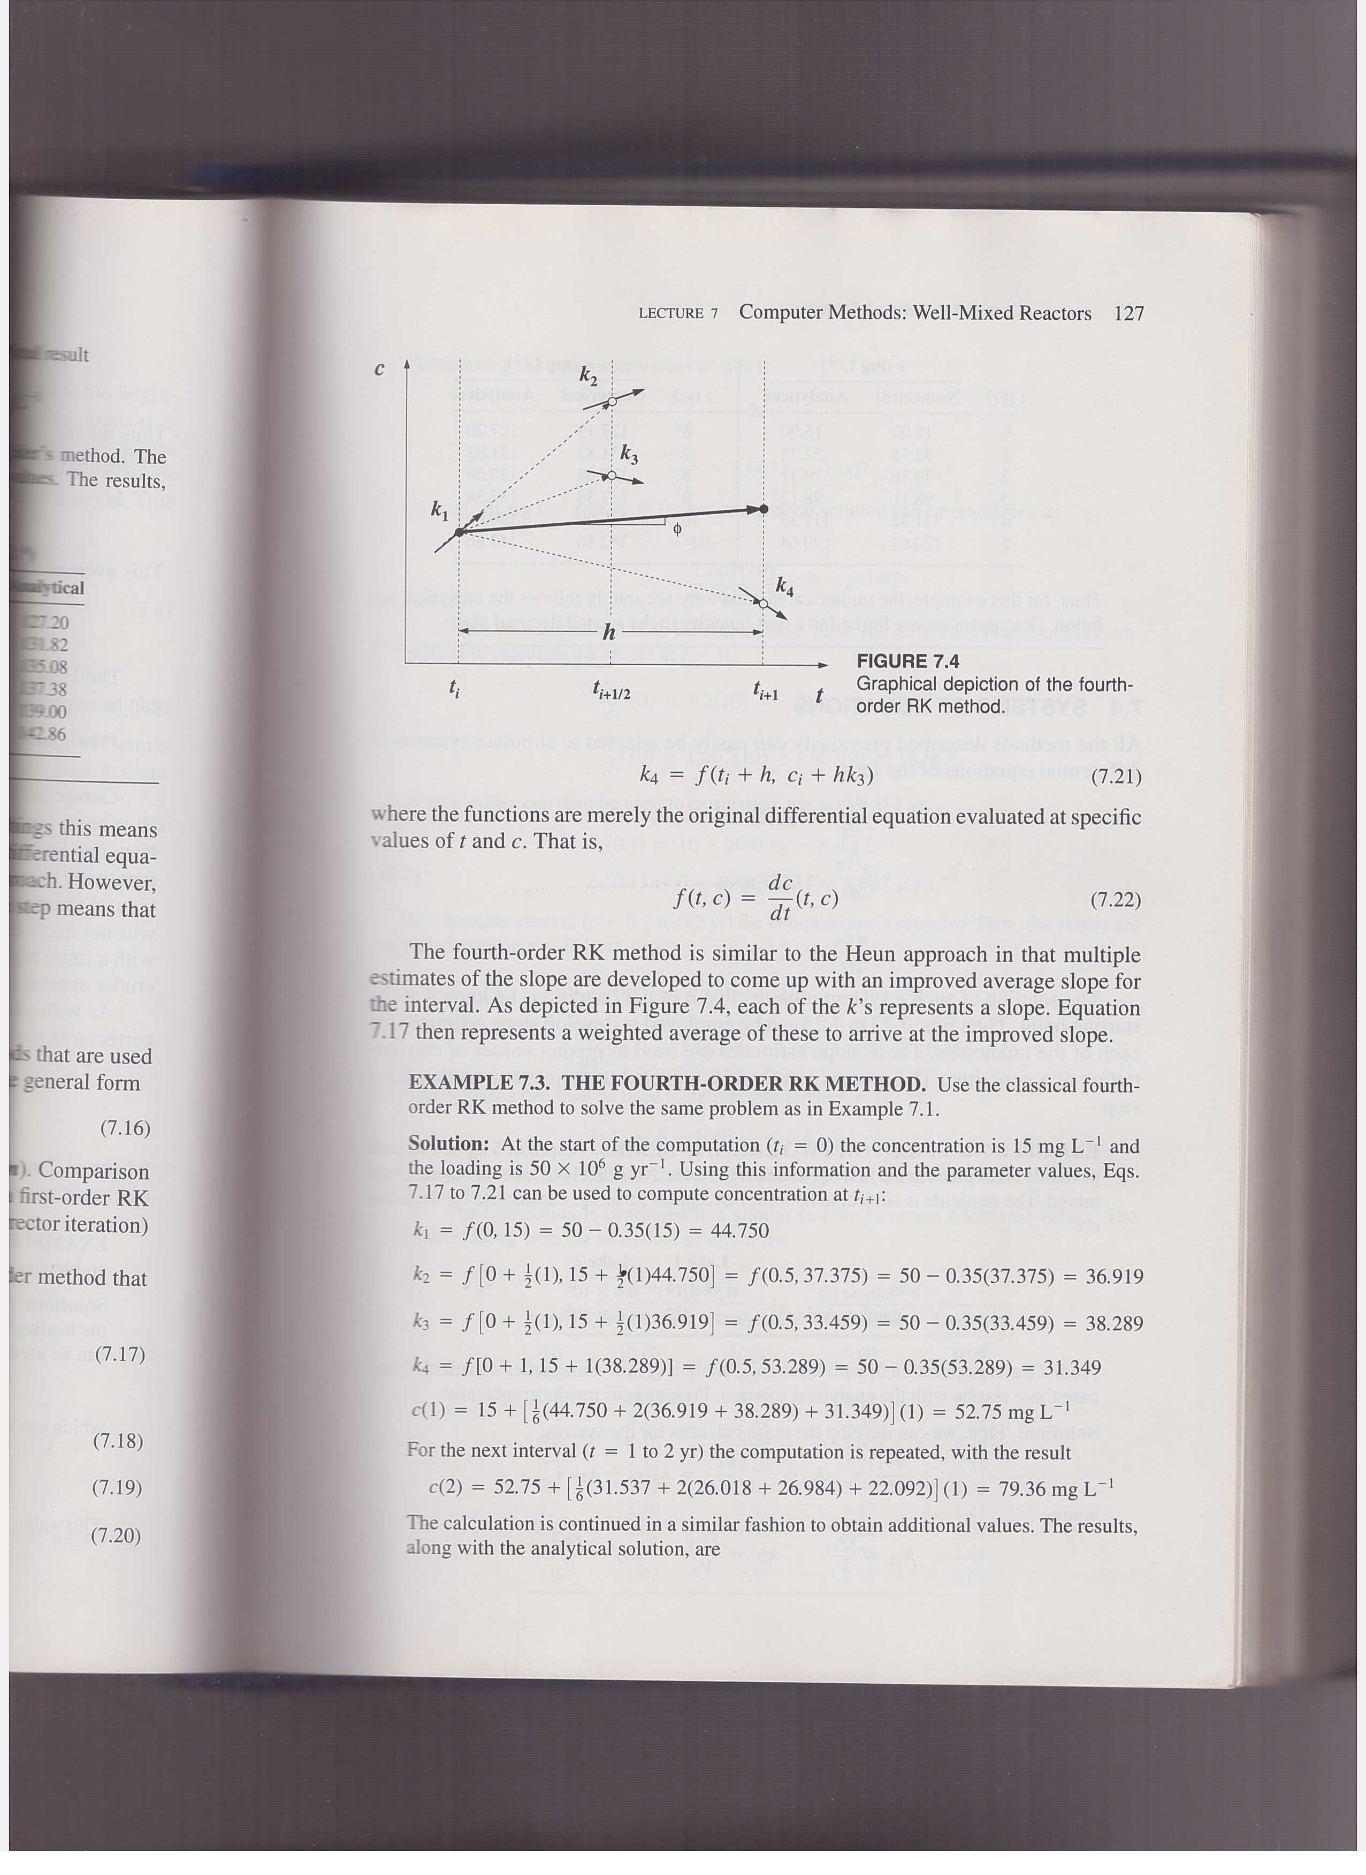
Runge-Kutta Methods for Numerical Integration
Euler Method
IV-order R-K Method
Source: Surface Water-Quality Modeling, Chapra, Steven (1997).

Slide 29
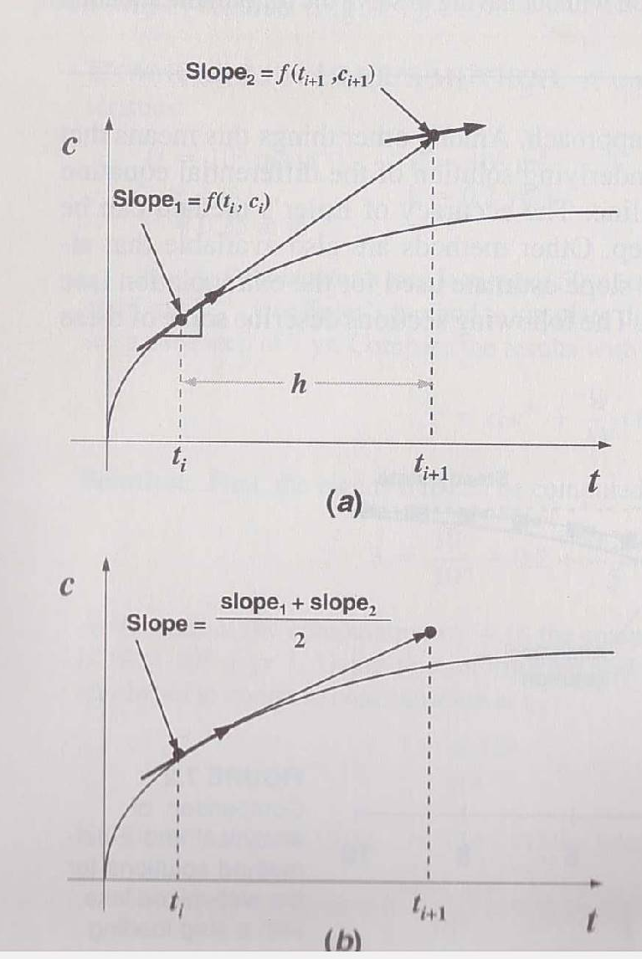
Heun’s Method: Predictor-Corrector
Source: Surface Water-Quality Modeling, Chapra, Steven (1997).

Slide 30
Ordinary Differential Equation
The methods for Initial Value Problems (IVPs):
Multi-step Methods
Explicit: Euler Forward, Adams-Bashforth
Implicit: Euler Backward, Trapezoidal and Adams-Moulton
Backward Difference Formulae (BDF)
Runge-Kutta Methods
Applications, Startup, Combination Methods (Predictor-Corrector)
Consistency, Stability, Convergence
Application to System of ODEs
Boundary Value Problems (BVPs)
Shooting Method
Direct Methods

Slide 31
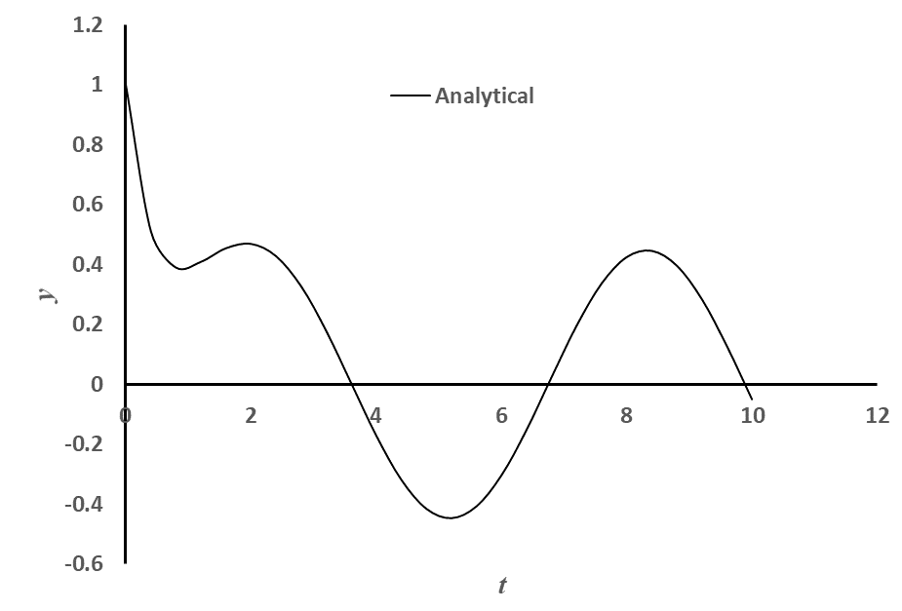
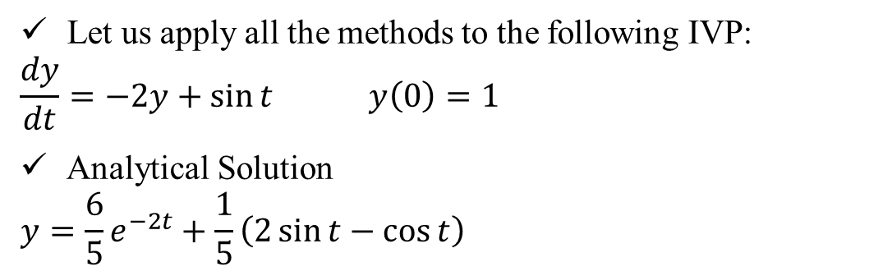
The Problem
,
Let us apply all the methods to the following IVP:
$$\frac{dy}{dt}=−2y+\sin{t} y\left(0\right)=1$$
Analytical Solution
$$y=\frac{6}{5}e^{−2t}+\frac{1}{5}\left(2\sin{t}−\cos{t}\right)$$

Slide 32
Application: Multi-Step Methods (explicit)
,
$$y_{n+1}=y_{n}+h\sum_{i=0}^{k}{α_{i}f_{n−i}}$$
Some commonly used explicit methods:
Name | k | Method | GTE Order
Euler Forward | 0 | $$y_{n+1}=y_{n}+hf_{n}$$ | h
Adams-Bashforth | 1 | $$y_{n+1}=y_{n}+h\left(\frac{3}{2}f_{n}−\frac{1}{2}f_{n−1}\right)$$ | h²
 | 2 | $$y_{n+1}=y_{n}+h\left(\frac{23}{12}f_{n}−\frac{4}{3}f_{n−1}+\frac{5}{12}f_{n−2}\right)$$ | h³
 | 3 | $$y_{n+1}=y_{n}+h\left(\frac{55}{24}f_{n}−\frac{59}{24}f_{n−1}+\frac{37}{24}f_{n−2}−\frac{3}{8}f_{n−3}\right)$$ | h⁴

Slide 33
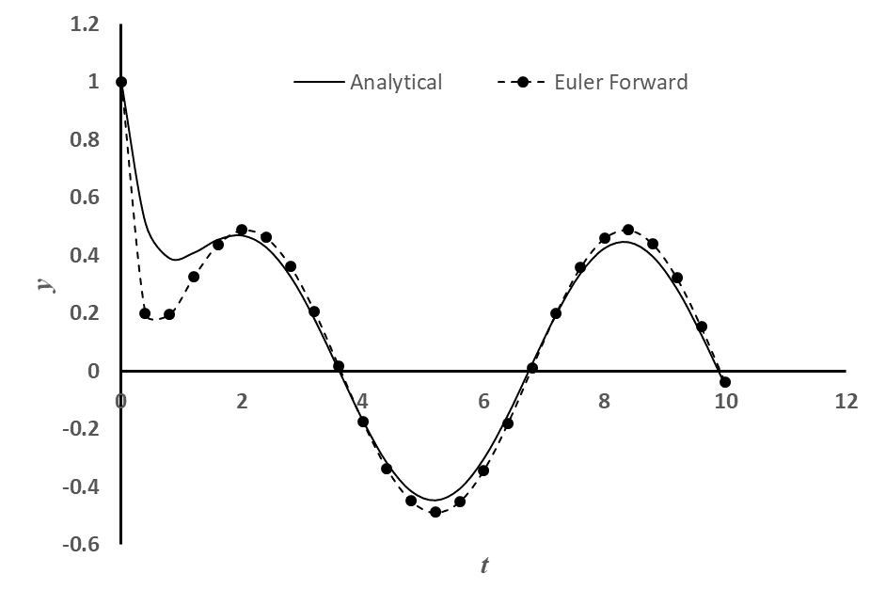
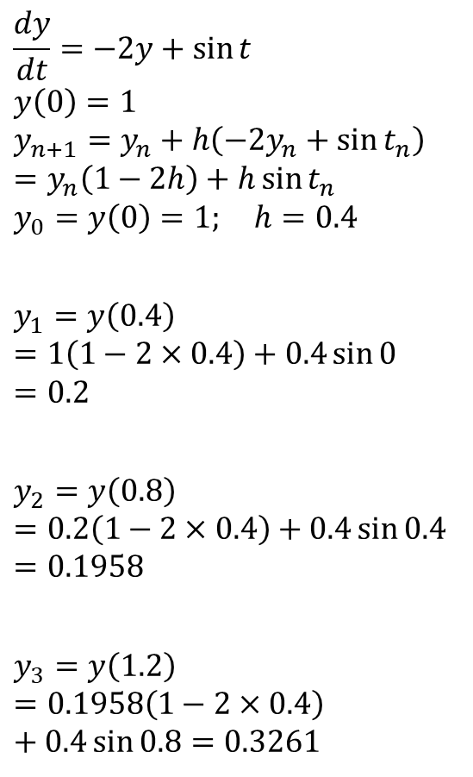
Euler Forward
,
$$\frac{dy}{dt}=−2y+\sin{t}$$
$$y\left(0\right)=1$$
$$y_{n+1}=y_{n}+h\left(−2y_{n}+\sin{t_{n}}\right)=y_{n}\left(1−2h\right)+h\sin{t_{n}}$$
$$y_{0}=y\left(0\right)=1; h=0.4$$
$$y_{1}=y\left(0.4\right)=1\left(1−2×0.4\right)+0.4\sin{0}=0.2$$
$$y_{2}=y\left(0.8\right)=0.2\left(1−2×0.4\right)+0.4\sin{0.4}=0.1958$$
$$y_{3}=y\left(1.2\right)=0.1958\left(1−2×0.4\right)+0.4\sin{0.8}=0.3261$$
Continuing like this for 25 time steps to t = 10

Slide 34
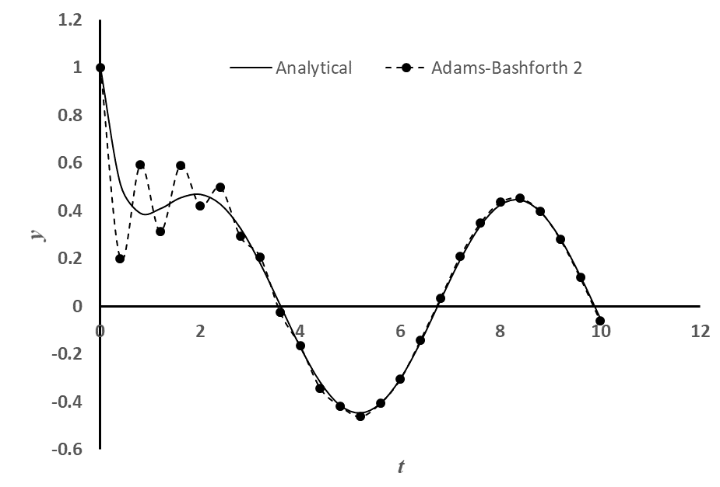
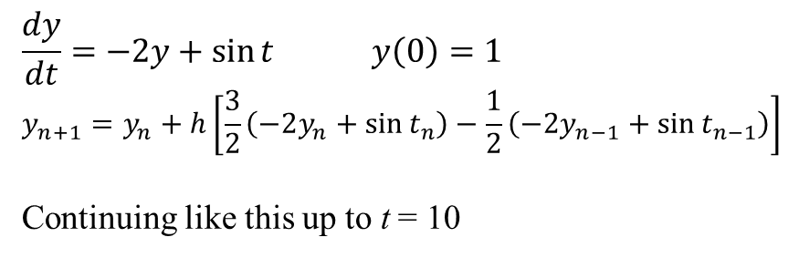
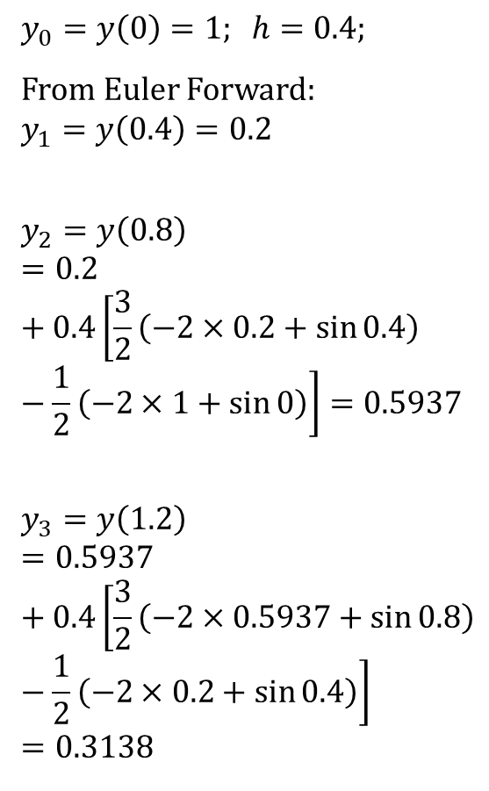
Adams-Bashforth (2nd Order)
,
$$y_{0}=y\left(0\right)=1; h=0.4;$$
From Euler Forward:
$$y_{1}=y\left(0.4\right)=0.2$$
$$y_{2}=y\left(0.8\right)=0.2+0.4\left[\frac{3}{2}\left(−2×0.2+\sin{0.4}\right)−\frac{1}{2}\left(−2×1+\sin{0}\right)\right]=0.5937$$
$$y_{3}=y\left(1.2\right)=0.5937+0.4\left[\frac{3}{2}\left(−2×0.5937+\sin{0.8}\right)−\frac{1}{2}\left(−2×0.2+\sin{0.4}\right)\right]=0.3138$$
$$\frac{dy}{dt}=−2y+\sin{t} y\left(0\right)=1$$
$$y_{n+1}=y_{n}+h\left[\frac{3}{2}\left(−2y_{n}+\sin{t_{n}}\right)−\frac{1}{2}\left(−2y_{n−1}+\sin{t_{n−1}}\right)\right]$$
Continuing like this up to t = 10

Slide 35
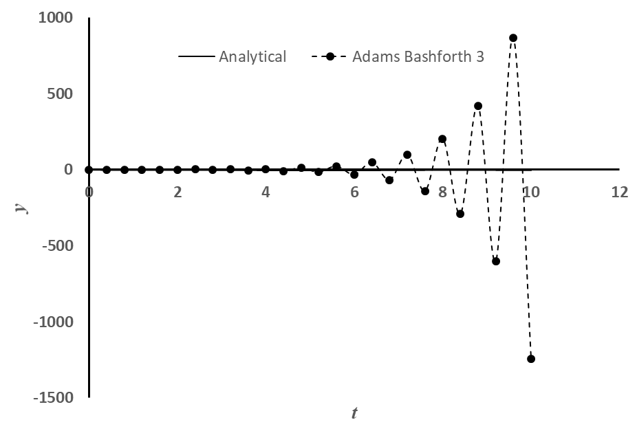
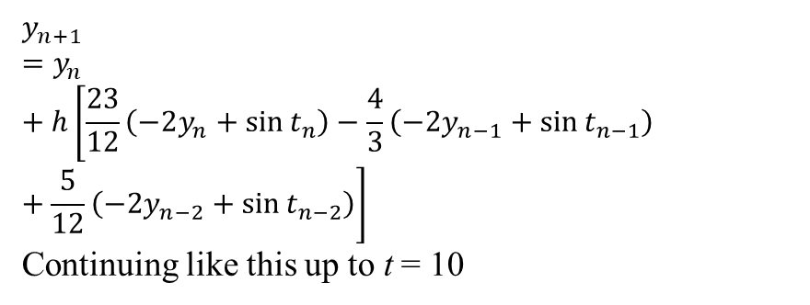
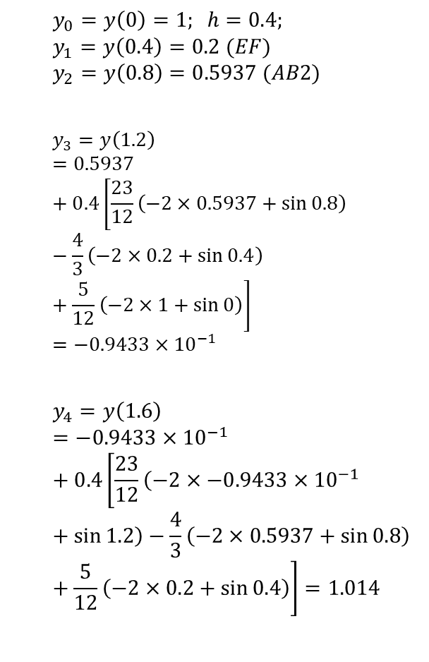
Adams-Bashforth (3rd Order)
,
$$y_{0}=y\left(0\right)=1; h=0.4;$$
$$y_{1}=y\left(0.4\right)=0.2 (EF)$$
$$y_{2}=y\left(0.8\right)=0.5937 (AB2)$$
$$y_{3}=y\left(1.2\right)=0.5937+0.4\left[\frac{23}{12}\left(−2×0.5937+\sin{0.8}\right)−\frac{4}{3}\left(−2×0.2+\sin{0.4}\right)+\frac{5}{12}\left(−2×1+\sin{0}\right)\right]=−0.9433×{10}^{−1}$$
$$y_{4}=y\left(1.6\right)=−0.9433×{10}^{−1}+0.4\left[\frac{23}{12}\left(−2×−0.9433×{10}^{−1}+\sin{1.2}\right)−\frac{4}{3}\left(−2×0.5937+\sin{0.8}\right)+\frac{5}{12}\left(−2×0.2+\sin{0.4}\right)\right]=1.014$$
$$y_{n+1}=y_{n}+h\left[\frac{23}{12}\left(−2y_{n}+\sin{t_{n}}\right)−\frac{4}{3}\left(−2y_{n−1}+\sin{t_{n−1}}\right)+\frac{5}{12}\left(−2y_{n−2}+\sin{t_{n−2}}\right)\right]$$
Continuing like this up to t = 10

Slide 36
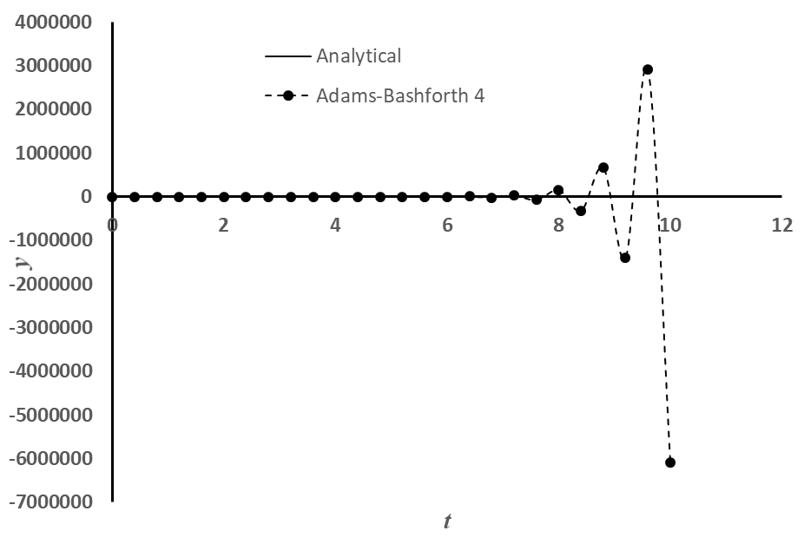
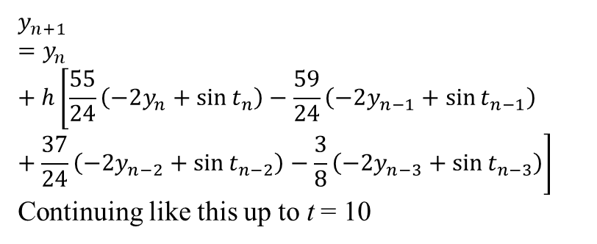
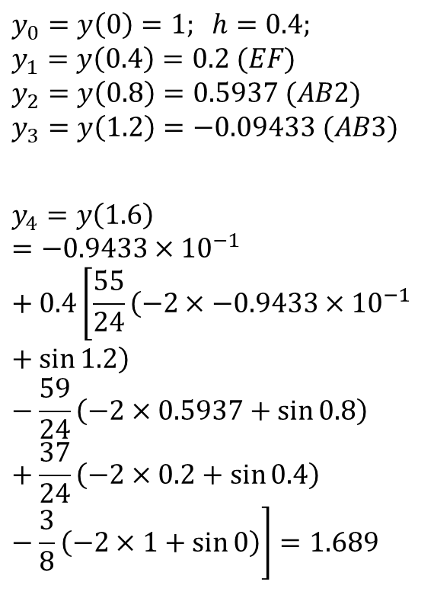
Adams-Bashforth (4th Order)
,
$$y_{n+1}=y_{n}+h\left[\frac{55}{24}\left(−2y_{n}+\sin{t_{n}}\right)−\frac{59}{24}\left(−2y_{n−1}+\sin{t_{n−1}}\right)+\frac{37}{24}\left(−2y_{n−2}+\sin{t_{n−2}}\right)−\frac{3}{8}\left(−2y_{n−3}+\sin{t_{n−3}}\right)\right]$$
Continuing like this up to t = 10
$$y_{0}=y\left(0\right)=1; h=0.4;$$
$$y_{1}=y\left(0.4\right)=0.2 (EF)$$
$$y_{2}=y\left(0.8\right)=0.5937 (AB2)$$
$$y_{3}=y\left(1.2\right)=−0.09433 (AB3)$$
$$y_{4}=y\left(1.6\right)=−0.9433×{10}^{−1}+0.4\left[\frac{55}{24}\left(−2×−0.9433×{10}^{−1}+\sin{1.2}\right)−\frac{59}{24}\left(−2×0.5937+\sin{0.8}\right)+\frac{37}{24}\left(−2×0.2+\sin{0.4}\right)−\frac{3}{8}\left(−2×1+\sin{0}\right)\right]=1.689$$

Slide 37
Euler Forward, Adams-Bashforth (2nd, 3rd and 4th Order)
,

Slide 38
Observations: explicit multi-step methods
A few things to note for multi-step explicit methods: Euler Forward, Adams-Bashforth
All methods above the first order cannot start by themselves:
how to solve the start-up problem?
Some strange oscillation showing up in some of the methods (uncontrolled growth, instability):
Is there a system to this?
Can it be predicted? How to know when this will happen?
Can it be avoided? If yes, then how?

Slide 39
Application: Multi-Step Methods (implicit)
,
$$y_{n+1}≈{\tilde{y}}_{n+1}=y_{n}+h\sum_{i=0}^{k}{β_{i}f_{n+1−i}}$$
Some commonly used implicit methods:
Name | k | Method | GTE Order
Euler Backward | 0 | $$y_{n+1}=y_{n}+hf_{n+1}$$ | h
Trapezoidal | 1 | $$y_{n+1}=y_{n}+h\left(\frac{1}{2}f_{n+1}+\frac{1}{2}f_{n}\right)$$ | h²
 | 2 | $$y_{n+1}=y_{n}+h\left(\frac{5}{12}f_{n+1}+\frac{2}{3}f_{n}−\frac{1}{12}f_{n−1}\right)$$ | h³
Adams-Moulton
 | 3 | $$y_{n+1}=y_{n}+h\left(\frac{3}{8}f_{n+1}+\frac{19}{24}f_{n}−\frac{5}{24}f_{n−1}+\frac{1}{24}f_{n−2}\right)$$ | h⁴

Slide 40
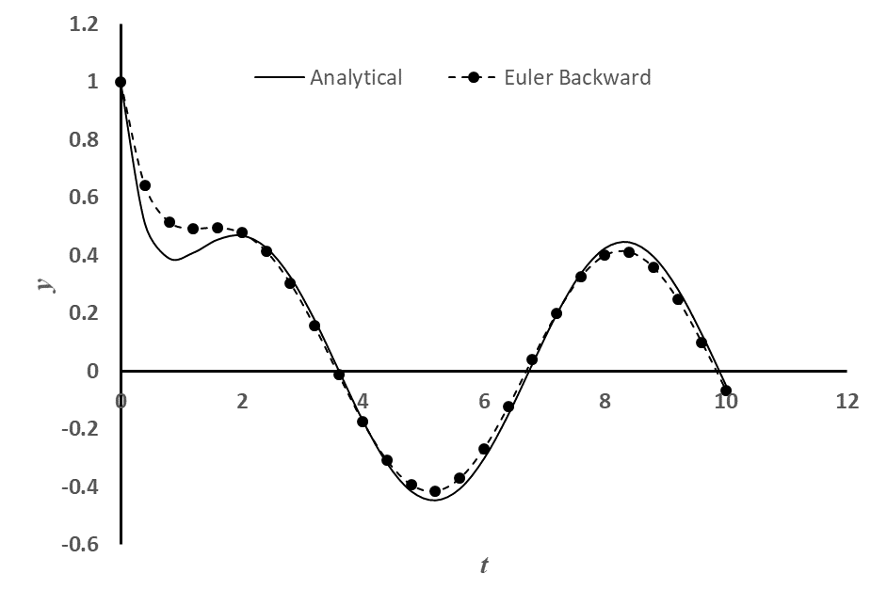
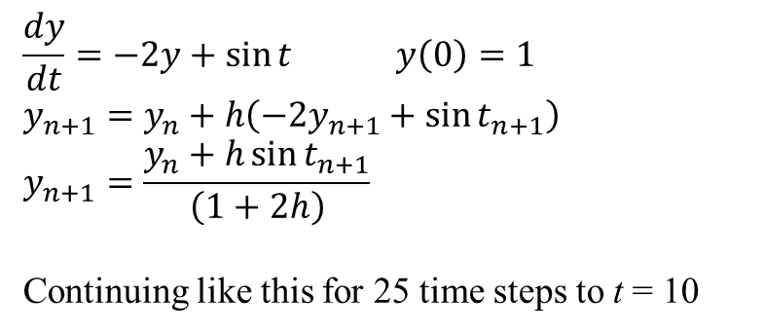
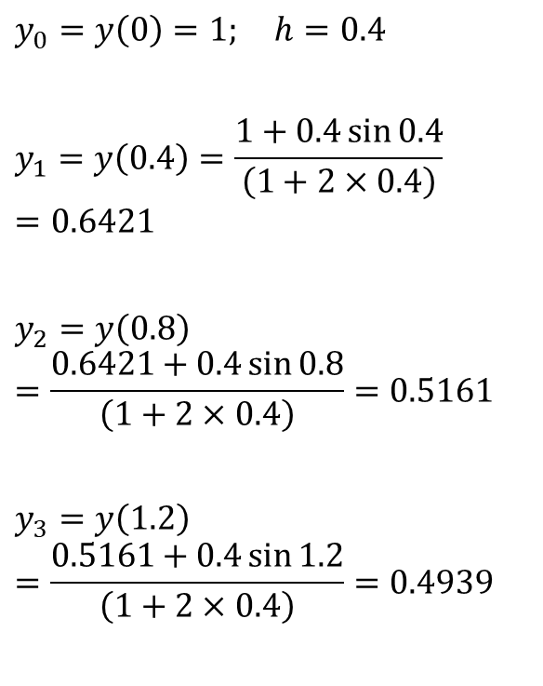
Euler Backward
,
$$\frac{dy}{dt}=−2y+\sin{t} y\left(0\right)=1$$
$$y_{n+1}=y_{n}+h\left(−2y_{n+1}+\sin{t_{n+1}}\right)$$
$$y_{n+1}=\frac{y_{n}+h\sin{t_{n+1}}}{\left(1+2h\right)}$$
Continuing like this for 25 time steps to t = 10
$$y_{0}=y\left(0\right)=1; h=0.4$$
$$y_{1}=y\left(0.4\right)=\frac{1+0.4\sin{0.4}}{\left(1+2×0.4\right)}=0.6421$$
$$y_{2}=y\left(0.8\right)=\frac{0.6421+0.4\sin{0.8}}{\left(1+2×0.4\right)}=0.5161$$
$$y_{3}=y\left(1.2\right)=\frac{0.5161+0.4\sin{1.2}}{\left(1+2×0.4\right)}=0.4939$$

Slide 41



Trapezoidal Method
,
$$y_{n+1}=y_{n}+\frac{h}{2}\left[\left(−2y_{n+1}+\sin{t_{n+1}}\right)+\left(−2y_{n}+\sin{t_{n}}\right)\right]$$
$$y_{n+1}=\frac{y_{n}\left(1−h\right)+\frac{h}{2}\left(\sin{t_{n+1}}+\sin{t_{n}}\right)}{\left(1+h\right)}$$
Continuing like this up to t = 10
$$y_{0}=y\left(0\right)=1; h=0.4$$
$$y_{1}=y\left(0.4\right)=\frac{1\left(1−0.4\right)+0.2\left(\sin{0}+\sin{0.4}\right)}{\left(1+0.4\right)}=0.4842$$
$$y_{2}=y\left(0.8\right)=\frac{0.4842\left(1−0.4\right)+0.2\left(\sin{0.4}+\sin{0.8}\right)}{\left(1+0.4\right)}=0.3656$$
$$y_{3}=y\left(1.2\right)=\frac{0.3656\left(1−0.4\right)+0.2\left(\sin{0.8}+\sin{1.2}\right)}{\left(1+0.4\right)}=0.3923$$

Slide 42

Adams-Moulton (3rd Order)
,
$$y_{n+1}=y_{n}+h\left[\frac{5}{12}\left(−2y_{n+1}+\sin{t_{n+1}}\right)+\frac{2}{3}\left(−2y_{n}+\sin{t_{n}}\right)−\frac{1}{12}\left(−2y_{n−1}+\sin{t_{n−1}}\right)\right]$$
$$y_{n+1}=\frac{y_{n}+h\left[\frac{5}{12}\sin{t_{n+1}}+\frac{2}{3}\left(−2y_{n}+\sin{t_{n}}\right)−\frac{1}{12}\left(−2y_{n−1}+\sin{t_{n−1}}\right)\right]}{\left(1+\frac{5}{6}h\right)}$$
$$y_{0}=y\left(0\right)=1; y_{1}=y\left(0.4\right)=0.6421 \left(EB\right); h=0.4$$
$$y_{2}=y\left(0.8\right)=\frac{0.6421+0.4\left[\frac{5}{12}\sin{0.8}+\frac{2}{3}\left(−2×0.6421+\sin{0.4}\right)−\frac{1}{12}\left(−2×1+\sin{0}\right)\right]}{\left(1+\frac{5}{6}×0.4\right)}=0.4423$$
$$y_{3}=y\left(1.2\right)=\frac{0.4423+0.4\left[\frac{5}{12}\sin{1.2}+\frac{2}{3}\left(−2×0.4423+\sin{0.8}\right)−\frac{1}{12}\left(−2×0.6421+\sin{0.4}\right)\right]}{\left(1+\frac{5}{6}×0.4\right)}=0.4371$$

Slide 43

Adams-Moulton (4th Order)
,
$$y_{n+1}=y_{n}+h\left[\frac{3}{8}\left(−2y_{n+1}+\sin{t_{n+1}}\right)+\frac{19}{24}\left(−2y_{n}+\sin{t_{n}}\right)−\frac{5}{24}\left(−2y_{n−1}+\sin{t_{n−1}}\right)+\frac{1}{24}\left(−2y_{n−2}+\sin{t_{n−2}}\right)\right]$$
$$y_{n+1}=\frac{y_{n}+h\left[\frac{3}{8}\sin{t_{n+1}}+\frac{19}{24}\left(−2y_{n}+\sin{t_{n}}\right)−\frac{5}{24}\left(−2y_{n−1}+\sin{t_{n−1}}\right)+\frac{1}{24}\left(−2y_{n−2}+\sin{t_{n−2}}\right)\right]}{\left(1+\frac{3}{4}h\right)}$$
$$y_{0}=y\left(0\right)=1; y_{1}=y\left(0.4\right)=0.6421 \left(EB\right); y_{2}=y\left(0.8\right)=0.4423 (AM3); h=0.4$$
$$y_{3}=y\left(1.2\right)=\frac{1}{\left(1+\frac{3}{4}×0.4\right)}\left\{0.4423+0.4\left[\frac{3}{8}\sin{1.2}+\frac{19}{24}\left(−2×0.4423+\sin{0.8}\right)−\frac{5}{24}\left(−2×0.6421+\sin{0.4}\right)−\frac{5}{24}\left(−2×1+\sin{0}\right)\right]\right\}=0.4387$$

Slide 44



Euler Backward, Trapezoidal, Adams-Moulton (3rd and 4th Order)
,

Slide 45
Observations: implicit multi-step methods
A few things to note for multi-step implicit methods: Euler Backward, Trapezoidal, Adams-Moulton
All methods above the second order cannot start by themselves. Accuracy of the higher order method is affected if the starting values are used from the lower order methods.
how to solve the start-up problem?
All implicit multi-step methods may involve solution of non-linear equations (if f contains a non-linear function of the dependent variable y)
Is there a way to avoid this solution of non-linear equations?
No numerical oscillations (instability) observed in any of the implicit methods:
Why the same order explicit multi-step methods show oscillation but implicit ones don’t?
Do they show oscillation under any conditions or are they oscillation-proof under all conditions?

Slide 46


Application: Backward Difference Formulae (BDF)
,
$$\sum_{i=0}^{k}{γ_{i}}y_{n+1−i}=hf_{n+1}$$
1st Order BDF is Euler Backward. Let’s apply the rest.
k | Method | GTE Order
1 | $$y_{n+1}−y_{n}=hf_{n+1}$$ | h
2 | $$\frac{3}{2}y_{n+1}−2y_{n}+\frac{1}{2}y_{n−1}=hf_{n+1}$$ | h²
3 | $$\frac{11}{6}y_{n+1}−3y_{n}+\frac{3}{2}y_{n−1}−\frac{1}{3}y_{n−2}=hf_{n+1}$$ | h³
4 | $$\frac{25}{12}y_{n+1}−4y_{n}+3y_{n−1}−\frac{4}{3}y_{n−2}+\frac{1}{4}y_{n−3}=hf_{n+1}$$ | h⁴
5 | $$\frac{137}{60}y_{n+1}−5y_{n}+5y_{n−1}−\frac{10}{3}y_{n−2}+\frac{5}{4}y_{n−3}−\frac{1}{5}y_{n−4}=hf_{n+1}$$ | h⁵
6 | $$\frac{49}{20}y_{n+1}−6y_{n}+\frac{15}{2}y_{n−1}−\frac{20}{3}y_{n−2}+\frac{15}{4}y_{n−3}−\frac{6}{5}y_{n−4}+\frac{1}{6}y_{n−5}=hf_{n+1}$$ | h⁶

Slide 47

BDF (1st and 2nd Order)
,
$$\frac{dy}{dt}=−2y+\sin{t} y\left(0\right)=1$$
1st Order (Euler Backward)
$$y_{n+1}−y_{n}=h\left(−2y_{n+1}+\sin{t_{n+1}}\right) or y_{n+1}=\frac{y_{n}+h\sin{t_{n+1}}}{\left(1+2h\right)}$$
2nd Order
$$\frac{3}{2}y_{n+1}−2y_{n}+\frac{1}{2}y_{n−1}=h\left(−2y_{n+1}+\sin{t_{n+1}}\right) ⟹ y_{n+1}=\frac{2y_{n}−\frac{1}{2}y_{n−1}+h\sin{t_{n+1}}}{\left(\frac{3}{2}+2h\right)}$$
$$h=0.4; y_{0}=y\left(0\right)=1; y_{1}=y\left(0.4\right)=0.6421 (EB)$$
$$y_{2}=y\left(0.8\right)=\frac{2×0.6421−\frac{1}{2}×1+0.4\sin{0.8}}{\left(\frac{3}{2}+2×0.4\right)}=0.4657$$
$$y_{3}=y\left(1.2\right)=\frac{2×0.4657−\frac{1}{2}×0.6421+0.4\sin{1.2}}{\left(\frac{3}{2}+2×0.4\right)}=0.4275$$

Slide 48

BDF (3rd and 4th Order)
,
3rd Order
$$\frac{11}{6}y_{n+1}−3y_{n}+\frac{3}{2}y_{n−1}−\frac{1}{3}y_{n−2}=h\left(−2y_{n+1}+\sin{t_{n+1}}\right)$$
$$y_{n+1}=\frac{3y_{n}−\frac{3}{2}y_{n−1}+\frac{1}{3}y_{n−2}+h\sin{t_{n+1}}}{\left(\frac{11}{6}+2h\right)}$$
$$h=0.4; y_{0}=y\left(0\right)=1; y_{1}=y\left(0.4\right)=0.6421 \left(EB\right); y_{2}=y\left(0.8\right)=0.4657 (BDF2)$$
$$y_{3}=y\left(1.2\right)=\frac{3×0.4657−\frac{3}{2}×0.6421+\frac{1}{3}×1+0.4\sin{1.2}}{\left(\frac{11}{6}+2×0.4\right)}=0.4330$$
4th Order
$$y_{n+1}=\frac{4y_{n}−3y_{n−1}+\frac{4}{3}y_{n−2}−\frac{1}{4}y_{n−3}+h\sin{t_{n+1}}}{\left(\frac{25}{12}+2h\right)}$$
$$h=0.4; y_{0}=y\left(0\right)=1; y_{1}=y\left(0.4\right)=0.6421 \left(EB\right);$$
$$y_{2}=y\left(0.8\right)=0.4657 \left(BDF2\right); y_{3}=y\left(1.2\right)=0.4330 (BDF3)$$
$$y_{4}=y\left(1.6\right)=\frac{4×0.4330−3×0.4657+\frac{4}{3}×0.6421−\frac{1}{4}×1+0.4\sin{1.6}}{\left(\frac{25}{12}+2×0.4\right)}=0.4650$$

Slide 49

BDF (5th and 6th Order)
,
5th Order
$$y_{n+1}=\frac{5y_{n}−5y_{n−1}+\frac{10}{3}y_{n−2}−\frac{5}{4}y_{n−3}+\frac{1}{5}y_{n−4}+h\sin{t_{n+1}}}{\left(\frac{137}{60}+2h\right)}$$
$$h=0.4; y_{0}=y\left(0\right)=1; y_{1}=y\left(0.4\right)=0.6421 \left(EB\right);$$
$$y_{2}=y\left(0.8\right)=0.4657 \left(BDF2\right); y_{3}=y\left(1.2\right)=0.4330 (BDF3); y_{4}=y\left(1.6\right)=0.4650 (BDF4)$$
$$y_{5}=y\left(2.0\right)=\frac{5×0.4650−5×0.4330+\frac{10}{3}×0.4657−\frac{5}{4}×0.6421+\frac{1}{5}×1+0.4\sin{2}}{\left(\frac{137}{60}+2×0.4\right)}=0.4779$$
6th Order
$$y_{n+1}=\frac{6y_{n}−\frac{15}{2}y_{n−1}+\frac{20}{3}y_{n−2}−\frac{15}{4}y_{n−3}+\frac{6}{5}y_{n−4}−\frac{1}{6}y_{n−5}+h\sin{t_{n+1}}}{\left(\frac{49}{20}+2h\right)}$$
$$h=0.4; y_{0}=y\left(0\right)=1; y_{1}=y\left(0.4\right)=0.6421 \left(EB\right); y_{2}=y\left(0.8\right)=0.4657 \left(BDF2\right);$$
$$y_{3}=y\left(1.2\right)=0.4330 (BDF3); y_{4}=y\left(1.6\right)=0.4650 (BDF4); y_{5}=y\left(2.0\right)=0.4779 (BDF5)$$
$$y_{5}=y\left(2.4\right)=\frac{6×0.4779−\frac{15}{2}×0.4650+\frac{20}{3}×0.4330−\frac{15}{4}×0.4657+\frac{6}{5}×0.6421−\frac{1}{6}×1+0.4\sin{2.4}}{\left(\frac{49}{20}+2×0.4\right)}=0.4290$$

Slide 50





BDF (1st to 6th Order)
,

Slide 51
Observations: BDF methods
A few things to note for the BDF:
All methods above the first order cannot start by themselves. Accuracy of the higher order method is affected if the starting values are used from the lower order methods.
how to solve the start-up problem?
All BDF may involve solution of non-linear equations (if f contains a non-linear function of the dependent variable y)
Is there a way to avoid this solution of non-linear equations?
No numerical oscillations (instability) observed in any of the BDFs:
Why the same order explicit multi-step methods show oscillation but BDFs do not?
Do they show oscillation under any conditions or are they oscillation-proof under all conditions?

Slide 52

Applications: Runge-Kutta (R-K) Methods
,
2nd Order Runge-Kutta (aka Ralston’s method):
$$y_{n+1}=y_{n}+h\left(\frac{φ_{0}}{3}+\frac{2φ_{1}}{3}\right)$$
$$φ_{0}=f\left(y_{n},t_{n}\right) φ_{1}=f\left(y_{n}+\frac{3}{4}hφ_{0},t_{n}+\frac{3}{4}h\right)$$
A 4th Order Runge-Kutta Method:
$$y_{n+1}=y_{n}+h\left(\frac{1}{6}φ_{0}+\frac{1}{3}\left(φ_{1}+φ_{2}\right)+\frac{1}{6}φ_{3}\right)$$
$$φ_{0}=f\left(y_{n},t_{n}\right) φ_{1}=f\left(y_{n}+\frac{1}{2}hφ_{0},t_{n}+\frac{1}{2}h\right)$$
$$φ_{2}=f\left(y_{n}+\frac{1}{2}hφ_{1},t_{n}+\frac{1}{2}h\right) φ_{3}=f\left(y_{n}+hφ_{2},t_{n}+h\right)$$

Slide 53

Runge-Kutta (R-K) Method (2nd Order)
,
$$\frac{dy}{dt}=−2y+\sin{t} y\left(0\right)=1$$
$$y_{n+1}=y_{n}+h\left(\frac{φ_{0}}{3}+\frac{2φ_{1}}{3}\right); φ_{0}=f\left(y_{n},t_{n}\right); φ_{1}=f\left(y_{n}+\frac{3}{4}hφ_{0},t_{n}+\frac{3}{4}h\right)$$
$$φ_{0}=−2y_{n}+\sin{t_{n}}; φ_{1}=−2\left(y_{n}+\frac{3}{4}hφ_{0}\right)+\sin\left(t_{n}+\frac{3}{4}h\right)$$
$$h=0.4; y_{0}=y\left(0\right)=1$$
$$φ_{0}=−2×1+\sin{0}=−2;φ_{1}=−2\left(1+\frac{3}{4}×0.4\left(−2\right)\right)+\sin\left(0+\frac{3}{4}×0.4\right)=−0.5045; y_{1}=1+0.4\left(\frac{−2}{3}+\frac{2\left(−0.5045\right)}{3}\right)=0.5988$$
$$φ_{0}=−2×0.5988+\sin{0.4}=−0.8082$$
$$φ_{1}=−2\left(0.5988+\frac{3}{4}×0.4\left(−0.8082\right)\right)+\sin\left(0.4+\frac{3}{4}×0.4\right)=−0.06848$$
$$y_{2}=0.5988+0.4\left(\frac{−0.8082}{3}+\frac{2\left(−0.06848\right)}{3}\right)=0.4728$$

Slide 54

Runge-Kutta (R-K) Method (4th Order)
,
$$\frac{dy}{dt}=−2y+\sin{t} y\left(0\right)=1$$
$$y_{n+1}=y_{n}+h\left(\frac{1}{6}φ_{0}+\frac{1}{3}\left(φ_{1}+φ_{2}\right)+\frac{1}{6}φ_{3}\right) φ_{0}=f\left(y_{n},t_{n}\right)$$
$$φ_{1}=f\left(y_{n}+\frac{1}{2}hφ_{0},t_{n}+\frac{1}{2}h\right); φ_{2}=f\left(y_{n}+\frac{1}{2}hφ_{1},t_{n}+\frac{1}{2}h\right); φ_{3}=f\left(y_{n}+hφ_{2},t_{n}+h\right)$$
$$φ_{0}=−2y_{n}+\sin{t_{n}}; φ_{1}=−2\left(y_{n}+\frac{1}{2}hφ_{0}\right)+\sin\left(t_{n}+\frac{h}{2}\right)$$
$$φ_{2}=−2\left(y_{n}+\frac{1}{2}hφ_{1}\right)+\sin\left(t_{n}+\frac{h}{2}\right); φ_{3}=−2\left(y_{n}+hφ_{2}\right)+\sin\left(t_{n}+h\right)$$
$$h=0.4; y_{0}=y\left(0\right)=1$$
$$φ_{0}=−2×1+\sin{0}=−2; φ_{1}=−2\left(1+\frac{0.4}{2}\left(−2\right)\right)+\sin\left(0+\frac{0.4}{2}\right)=−1.10013$$
$$φ_{2}=−2\left(1+\frac{0.4}{2}\left(−1.10013\right)\right)+\sin\left(0+\frac{0.4}{2}\right)=−1.4008$$
$$φ_{3}=−2\left(1+0.4\left(−1.4008\right)\right)+\sin\left(0+0.4\right)=−0.4899$$
$$y_{1}=y\left(0.4\right)=1+0.4\left(\frac{−2}{6}+\frac{\left(−1.10013−1.4008\right)}{3}+\frac{−0.4899}{6}\right)=0.5137$$

Slide 55

Runge-Kutta (R-K) Method (4th Order)
,
$$h=0.4; y_{1}=y\left(0.4\right)=0.5137$$
$$φ_{0}=−2×0.5137+\sin{0.4}=−0.6380$$
$$φ_{1}=−2\left(0.5137+\frac{0.4}{2}\left(−0.6380\right)\right)+\sin\left(0.4+\frac{0.4}{2}\right)=−0.2076$$
$$φ_{2}=−2\left(0.5137+\frac{0.4}{2}\left(−0.2076\right)\right)+\sin\left(0.4+\frac{0.4}{2}\right)=−0.3798$$
$$φ_{3}=−2\left(0.5137+0.4\left(−0.3798\right)\right)+\sin\left(0.4+0.4\right)=−0.00627$$
$$y_{3}=y\left(0.8\right)=1+0.4\left(\frac{−0.6380}{6}+\frac{\left(−0.2076−0.3798\right)}{3}+\frac{−0.00627}{6}\right)=0.3925$$

Slide 56


Runge-Kutta Methods (2nd and 4th Order)
,
A few things to note for the R-K:
All order methods are explicit!
None of them involve solution of non-linear equations
None of them have start-up problems!
At every time steps, number of FLOPs are larger for the R-K methods!
No numerical oscillations (instability) observed in any of the R-Ks:
Why the same order explicit multi-step methods show oscillation but R-Ks do not?
Do they show oscillation under any conditions or are they oscillation-proof under all conditions?

Slide 57
Applications: Summary of Concerns
Accuracy of the higher order multi-step and BDF methods are affected if the starting values are used from the lower order methods.
How to start these non-self starting algorithms?
All implicit methods (multi-step and BDF) may involve solution of non-linear equations (if f contains a non-linear function of the dependent variable y)
Is there a way to avoid this solution of non-linear equations?
Numerical oscillations (instability) observed in some methods and not in some!
Is there a way to predict and therefore, choose correct parameters for algorithm so that the numerical oscillations can be avoided?

